Slide 1
2004 Cross-shelf
28/11/2019

Slide 2
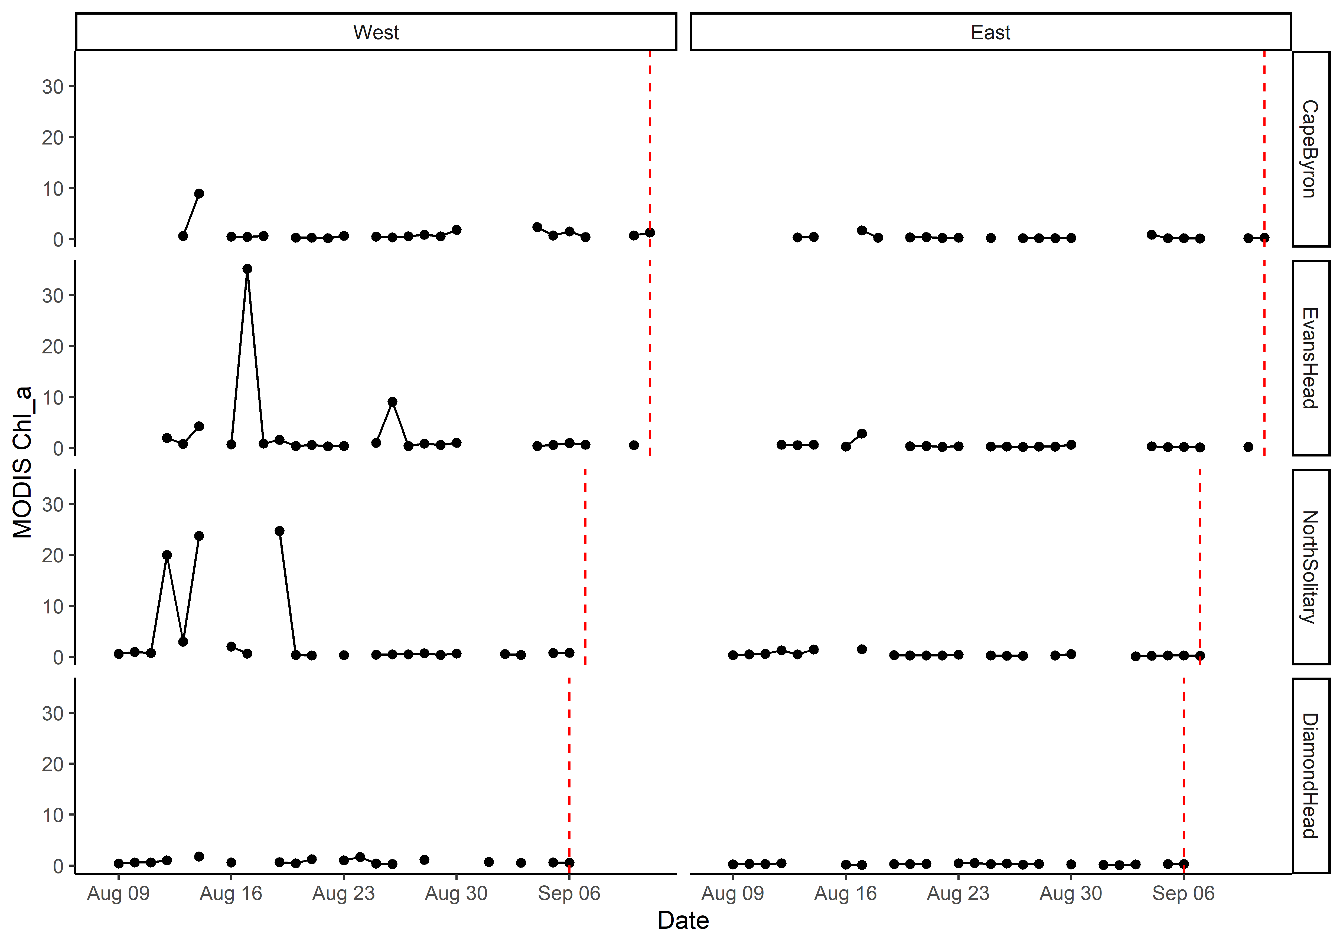
MODIS Chl_a

Slide 3
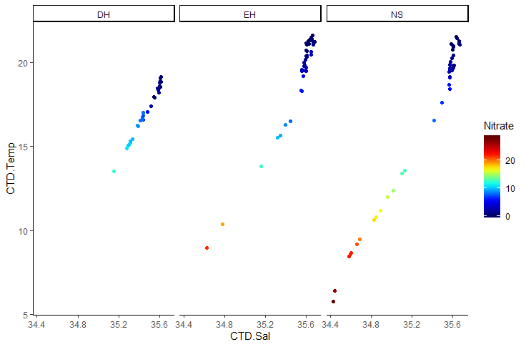
T-S Plot all depths (CTD)

Slide 4
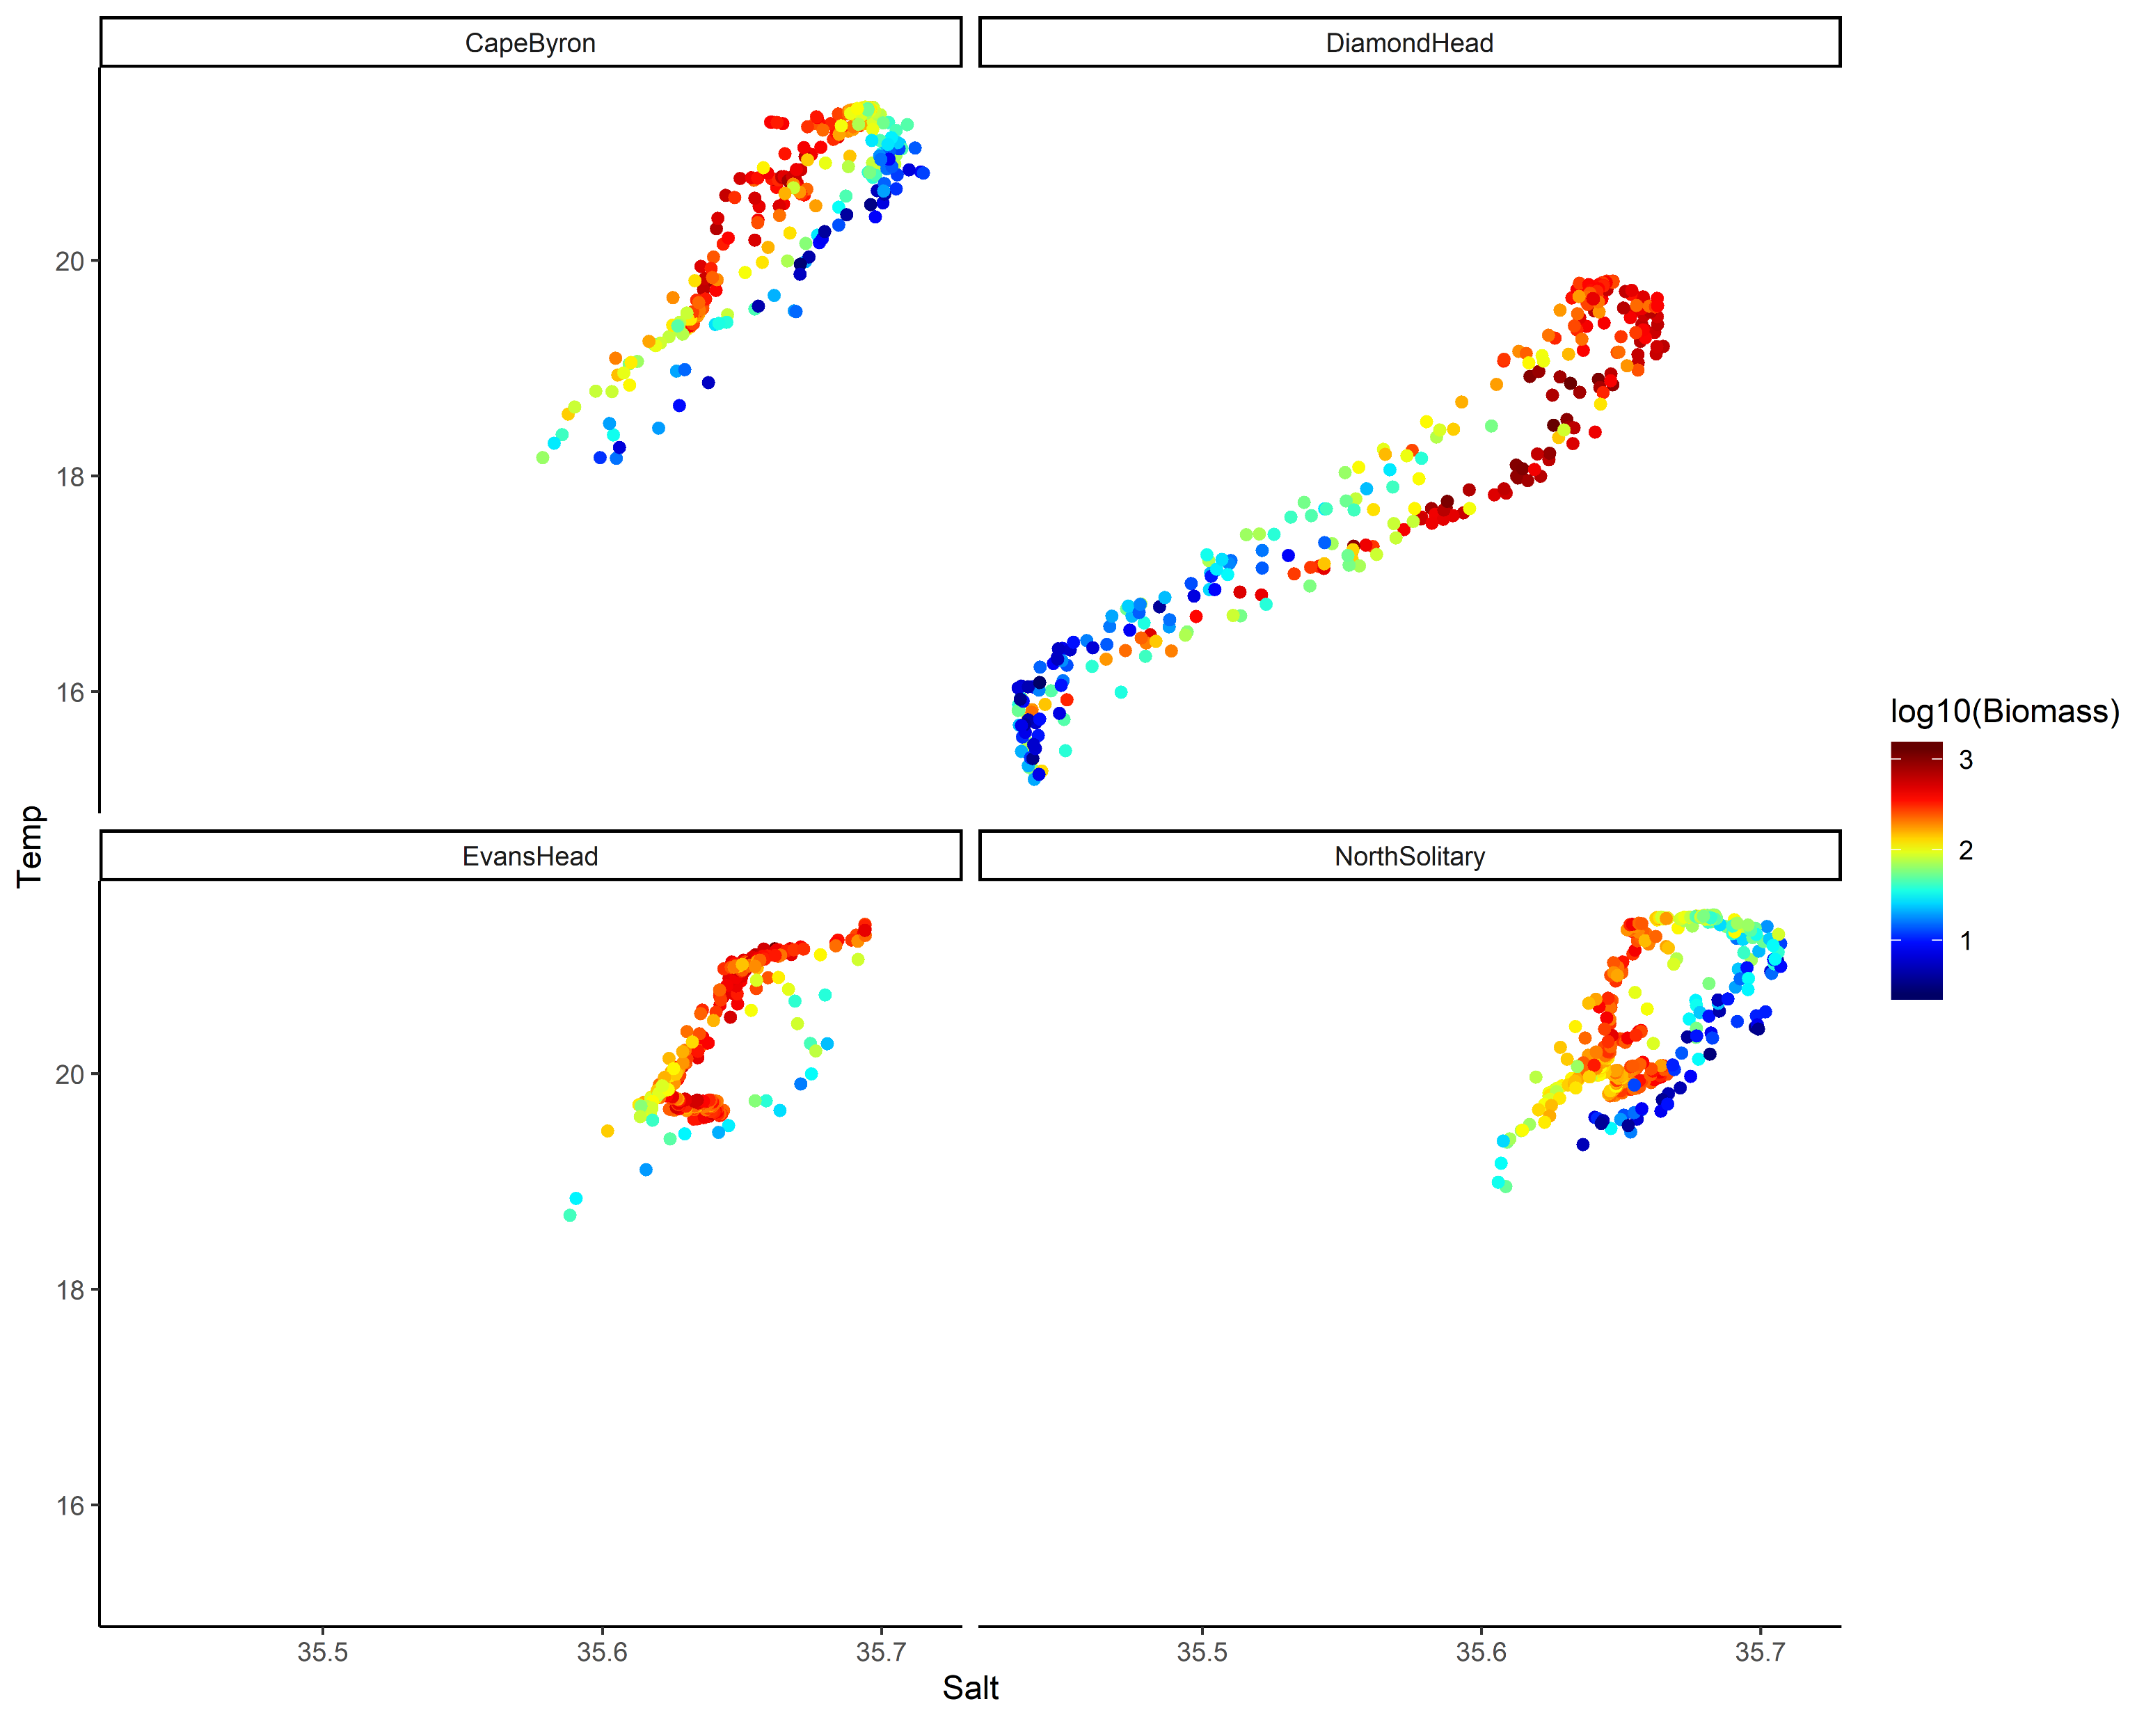
TS Plot by log₁₀(Biomass)

Slide 5
Key Questions
Aim: Describe the water and zooplankton characteristics across the East Australian shelf.
Water characteristics – physical oceanography
Zooplankton characteristics
Are they linked?
What is the larger context of these transects?

Slide 6
Water Characteristics
3 Transects go from inshore to EAC
Diamond Head is in a separation zone
See V-rotated velocities and Temperature
2 types of water mass, EAC influenced and separation zone
Compare northern 3 to Diamond Head

Slide 7
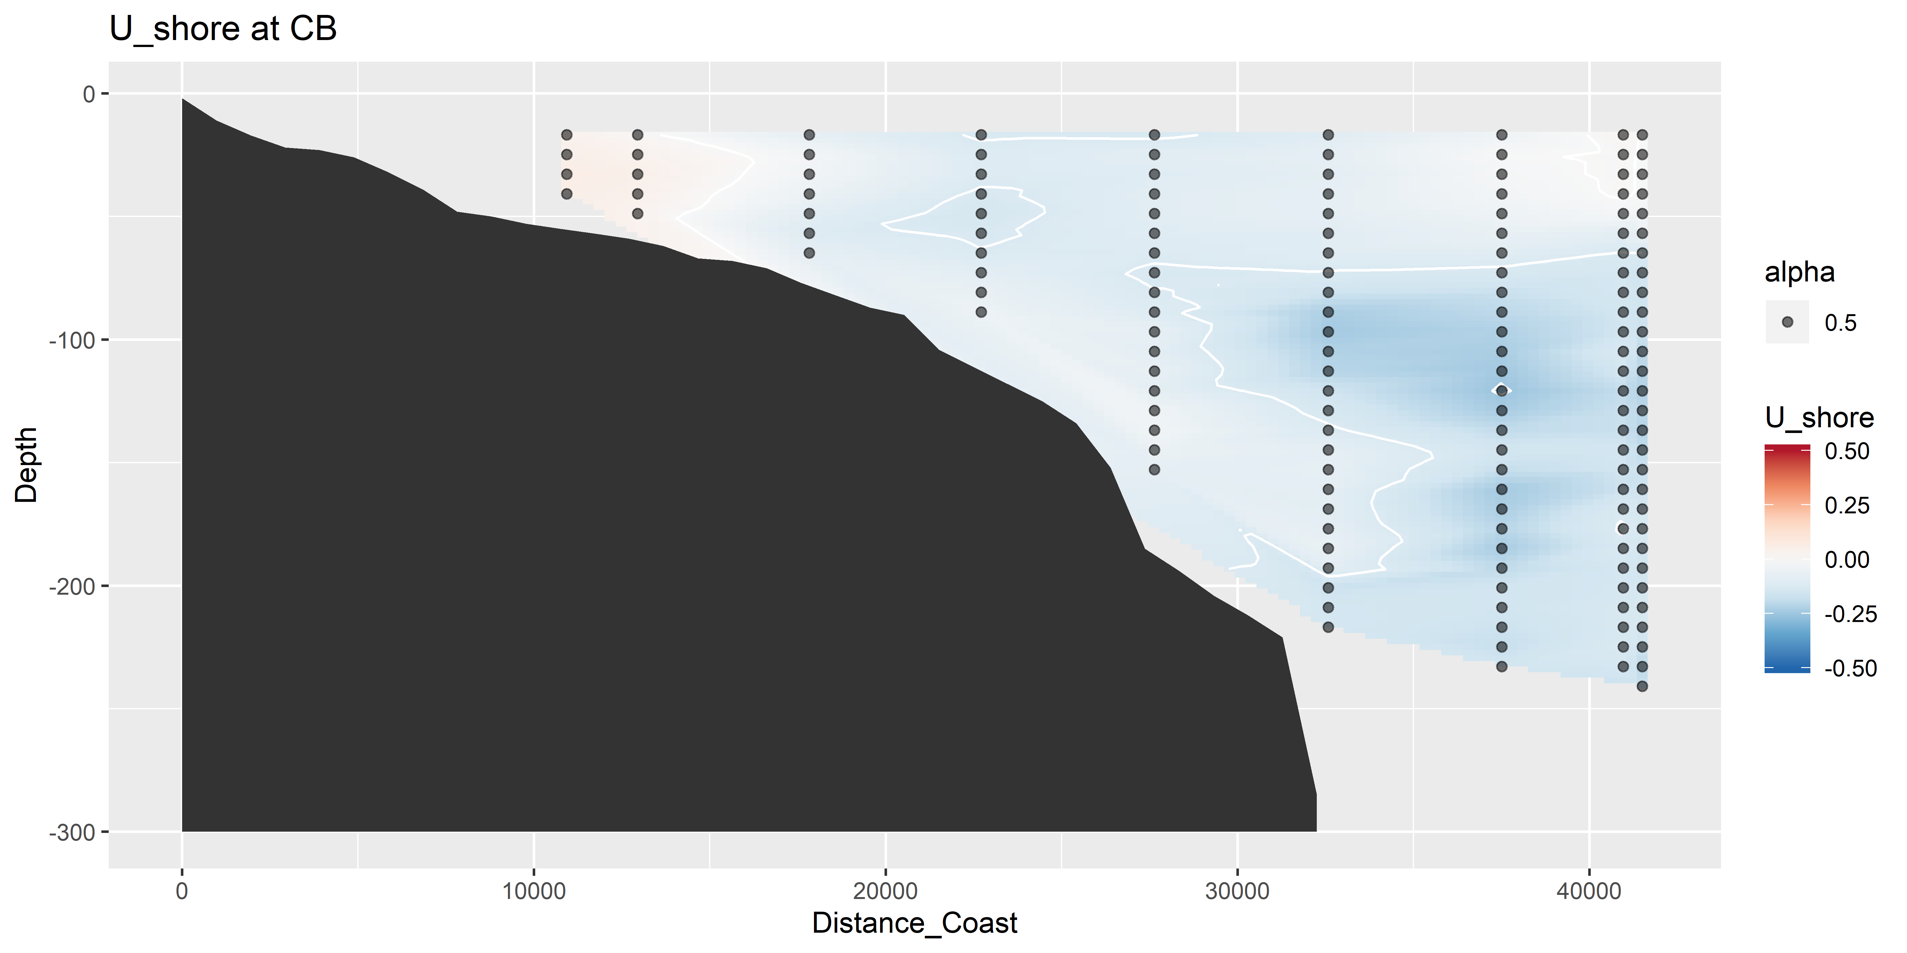
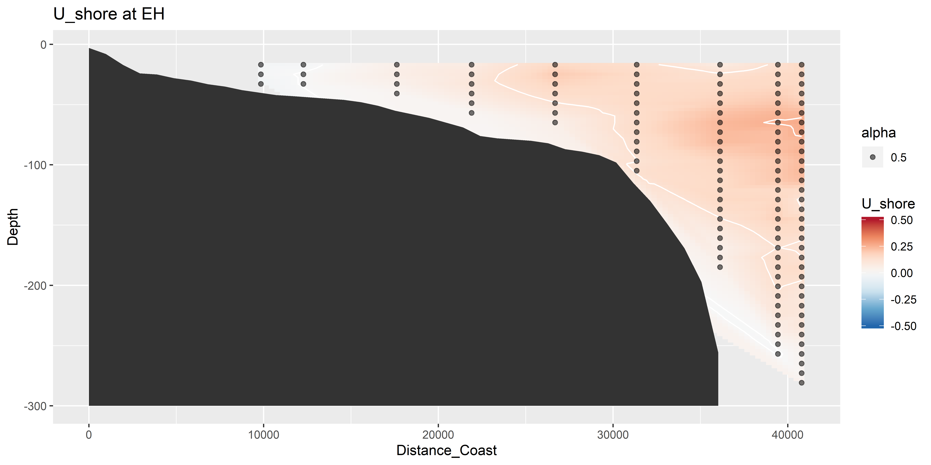
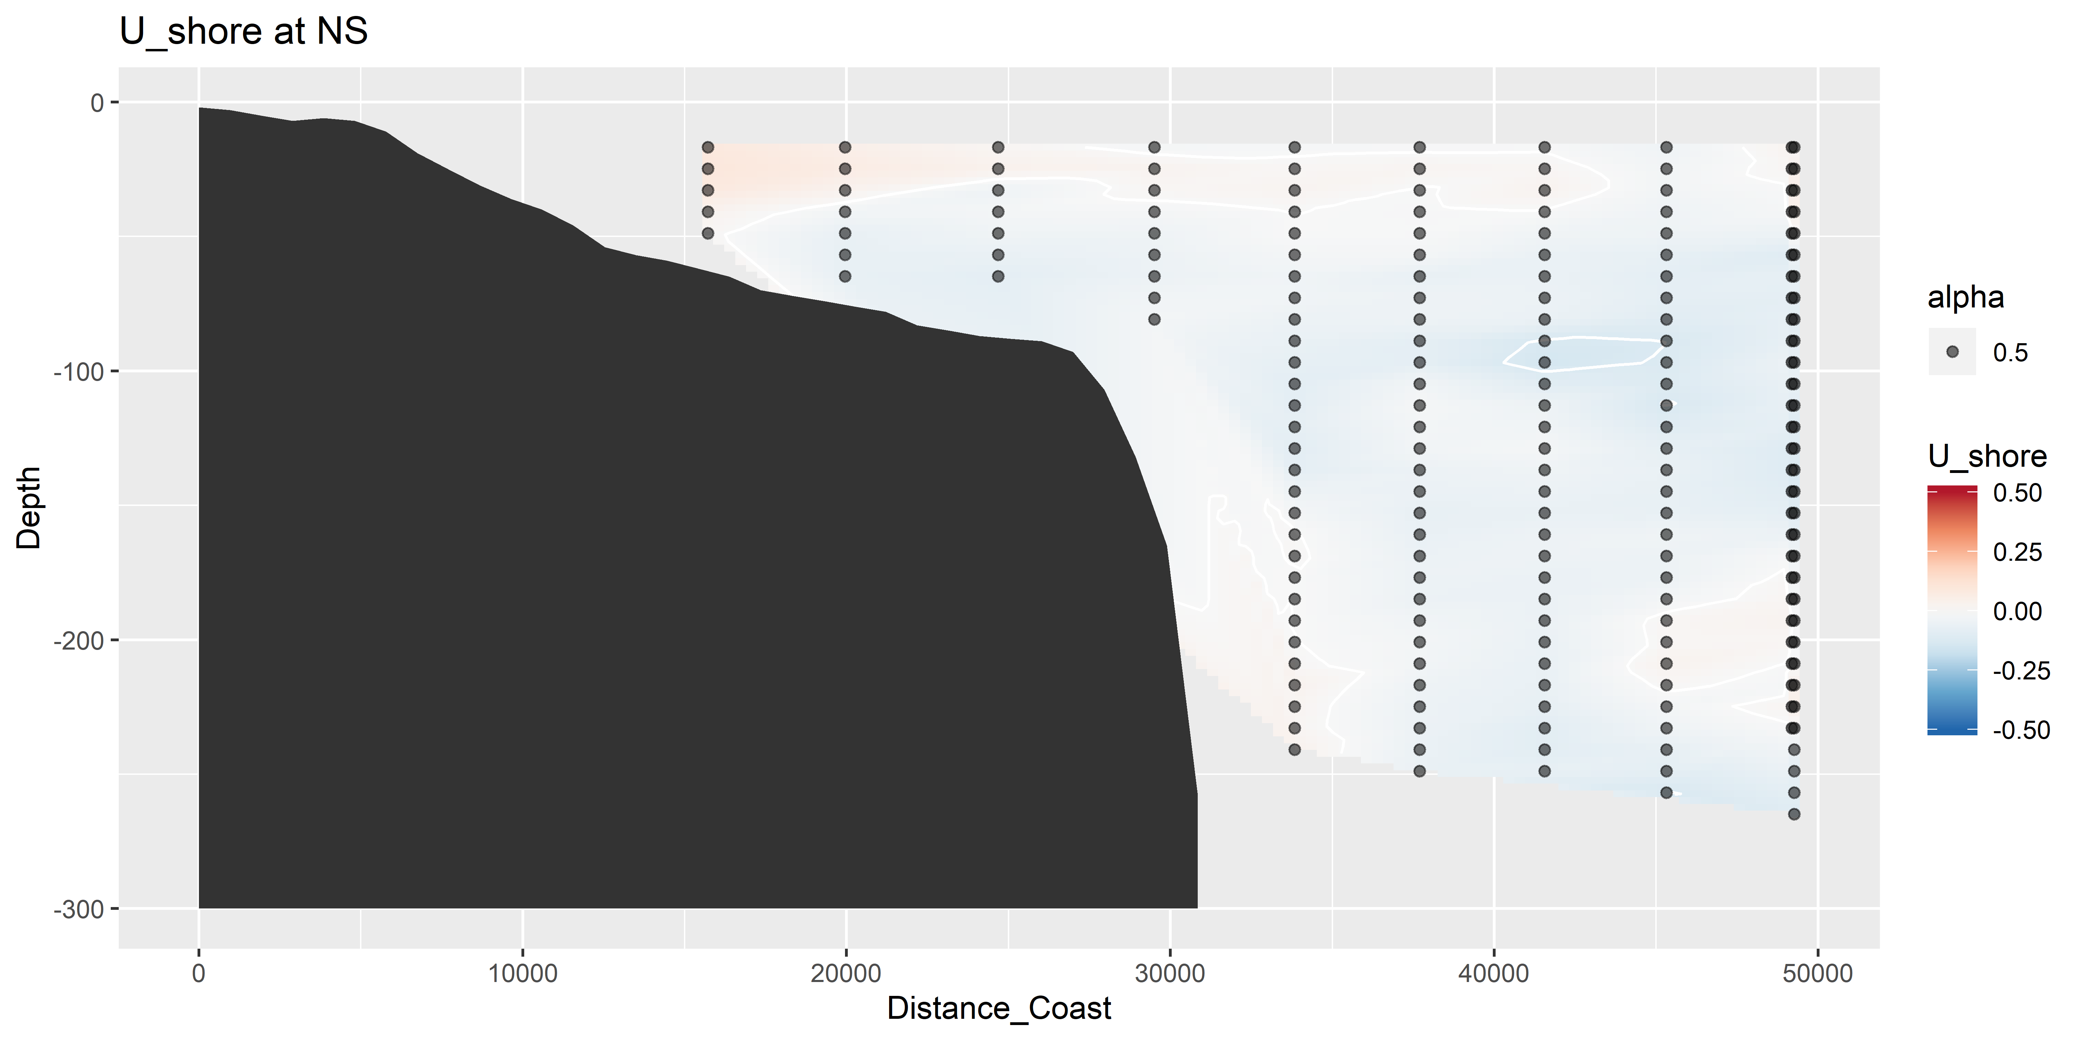
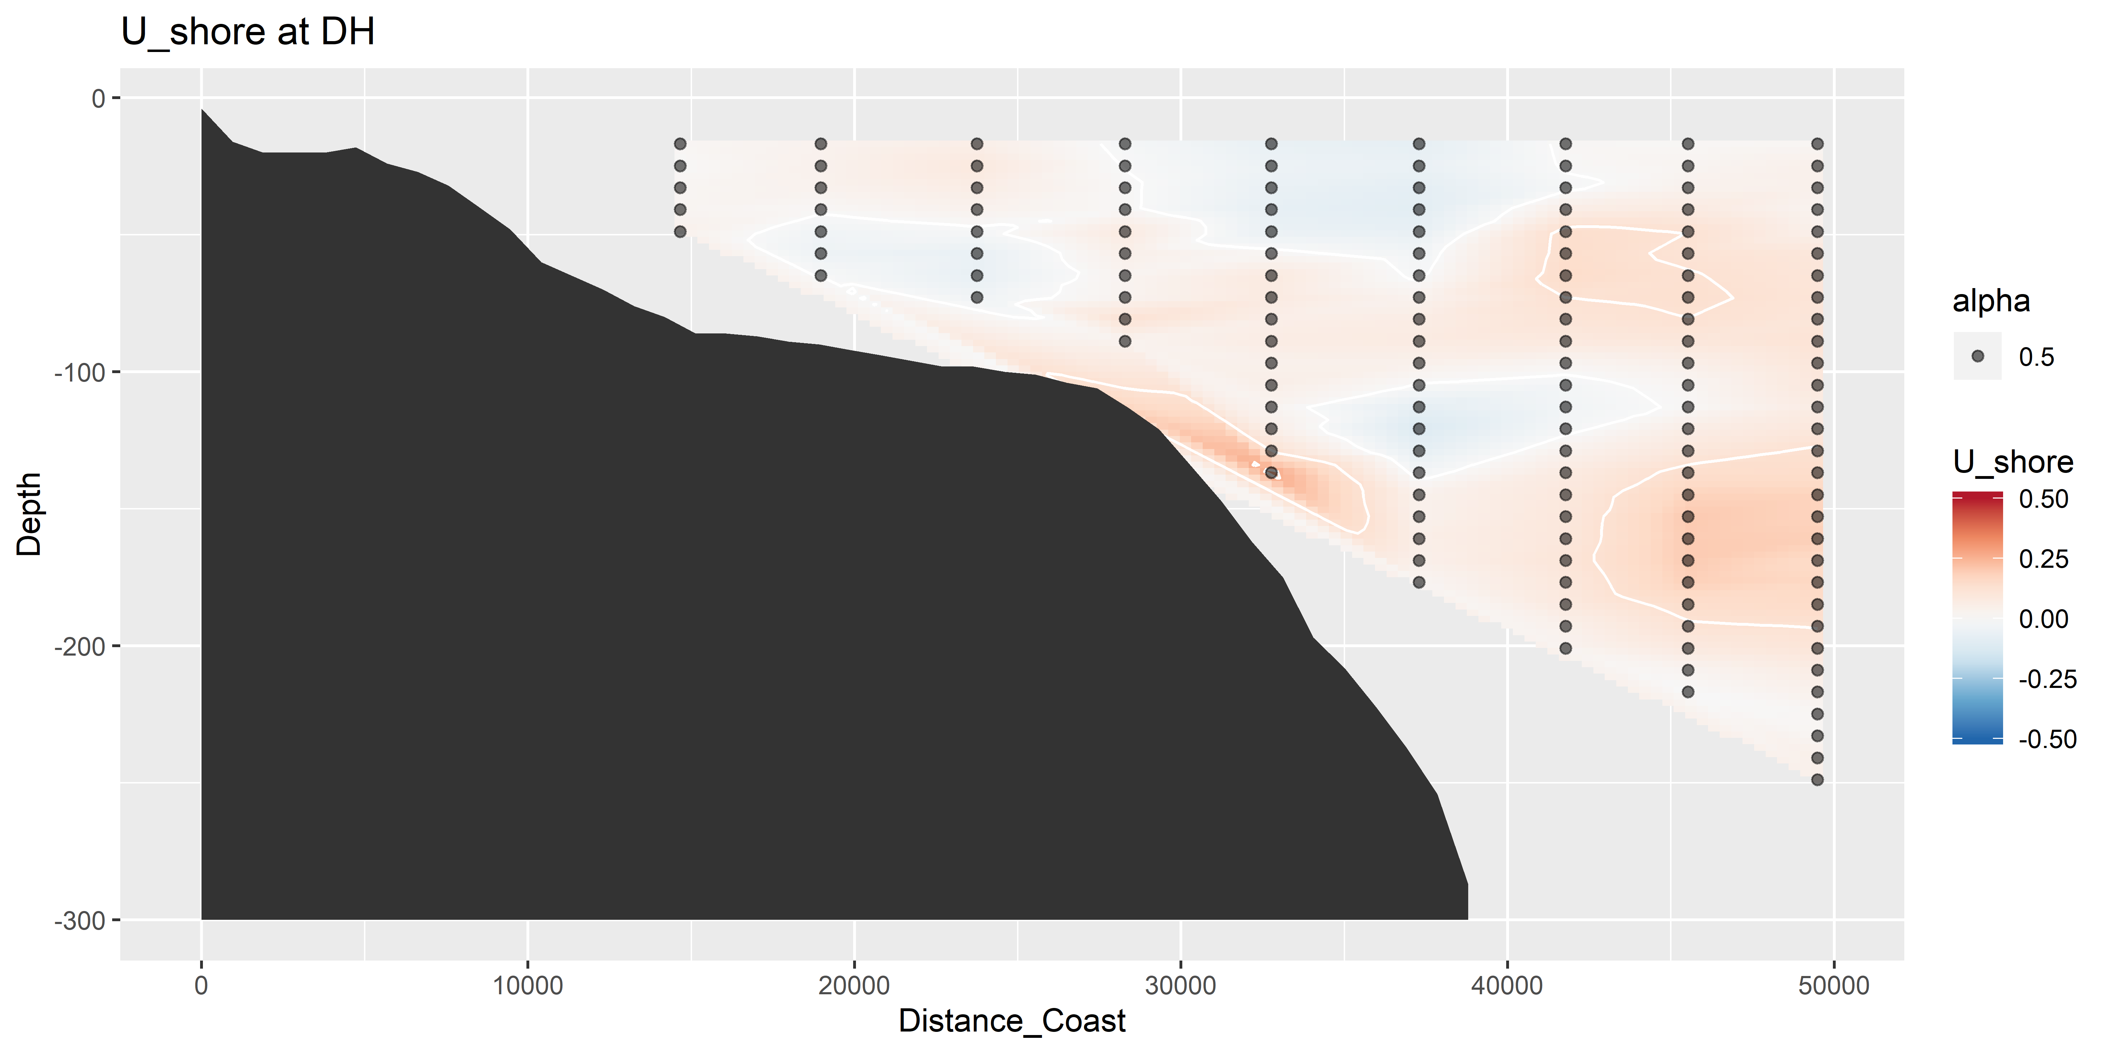
U vectors – shoreline rotated (m s⁻¹)

Slide 8
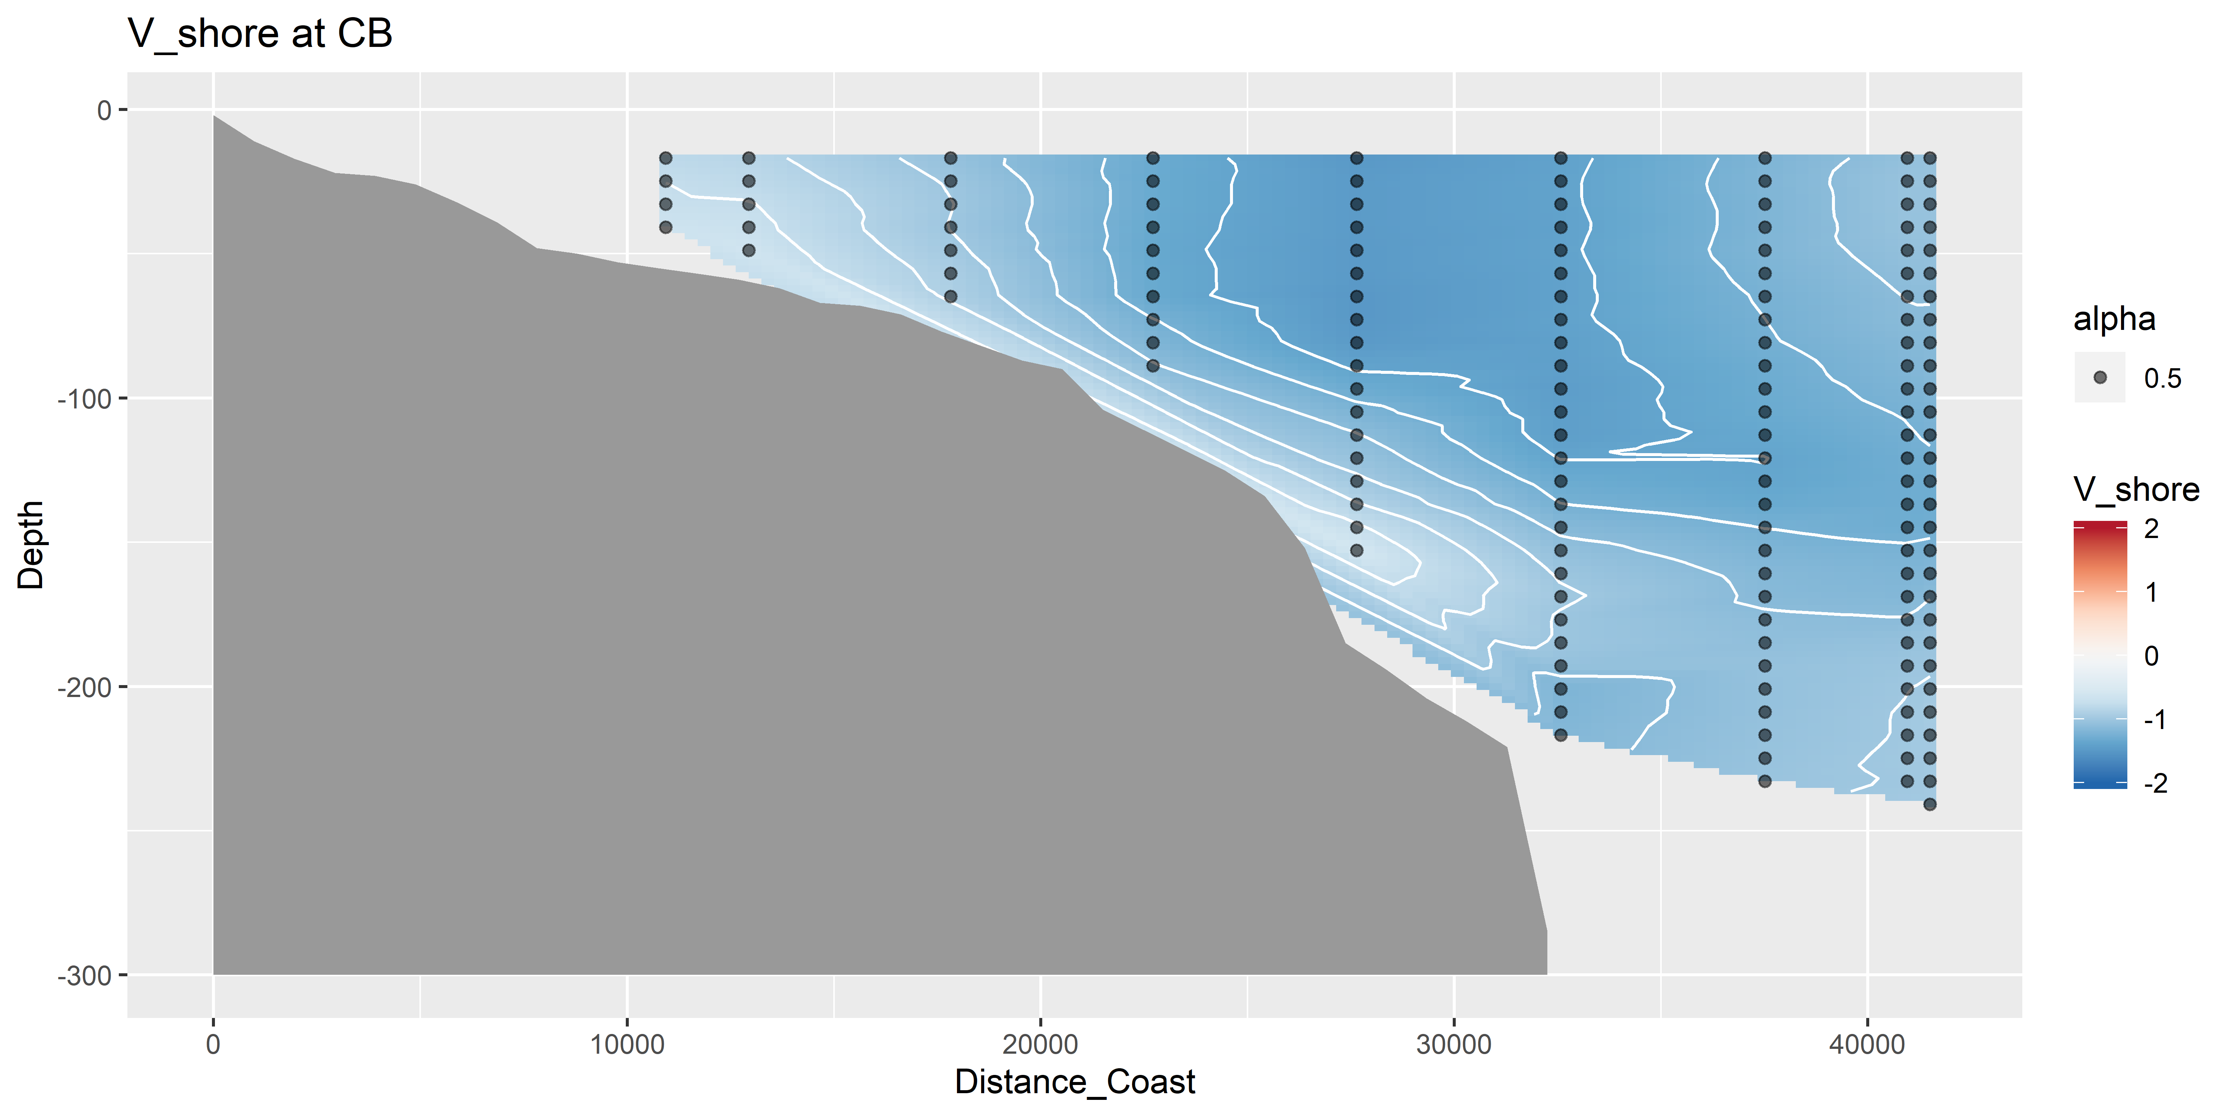
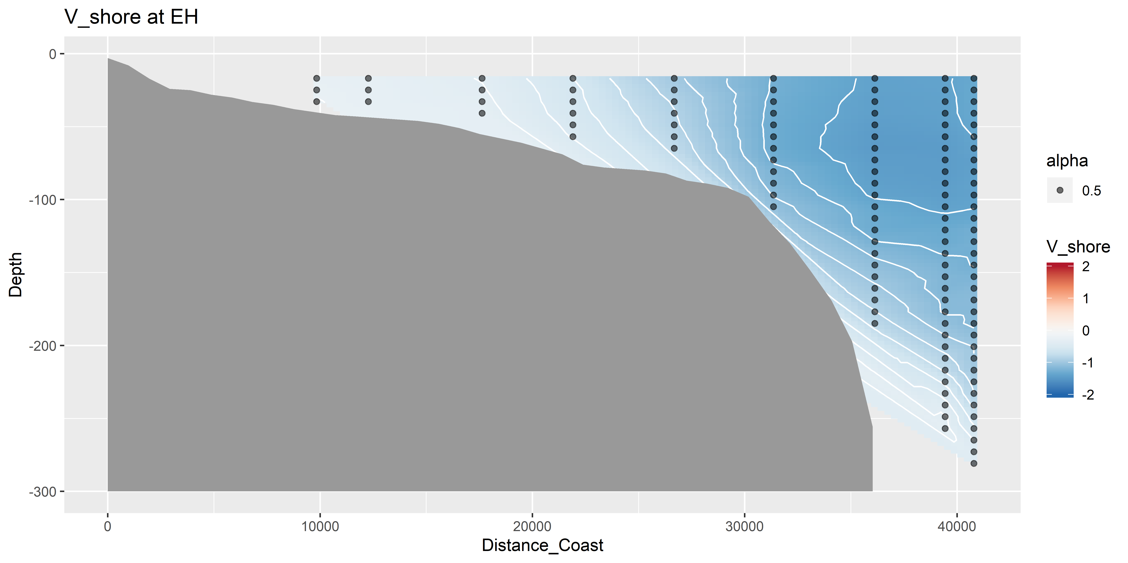
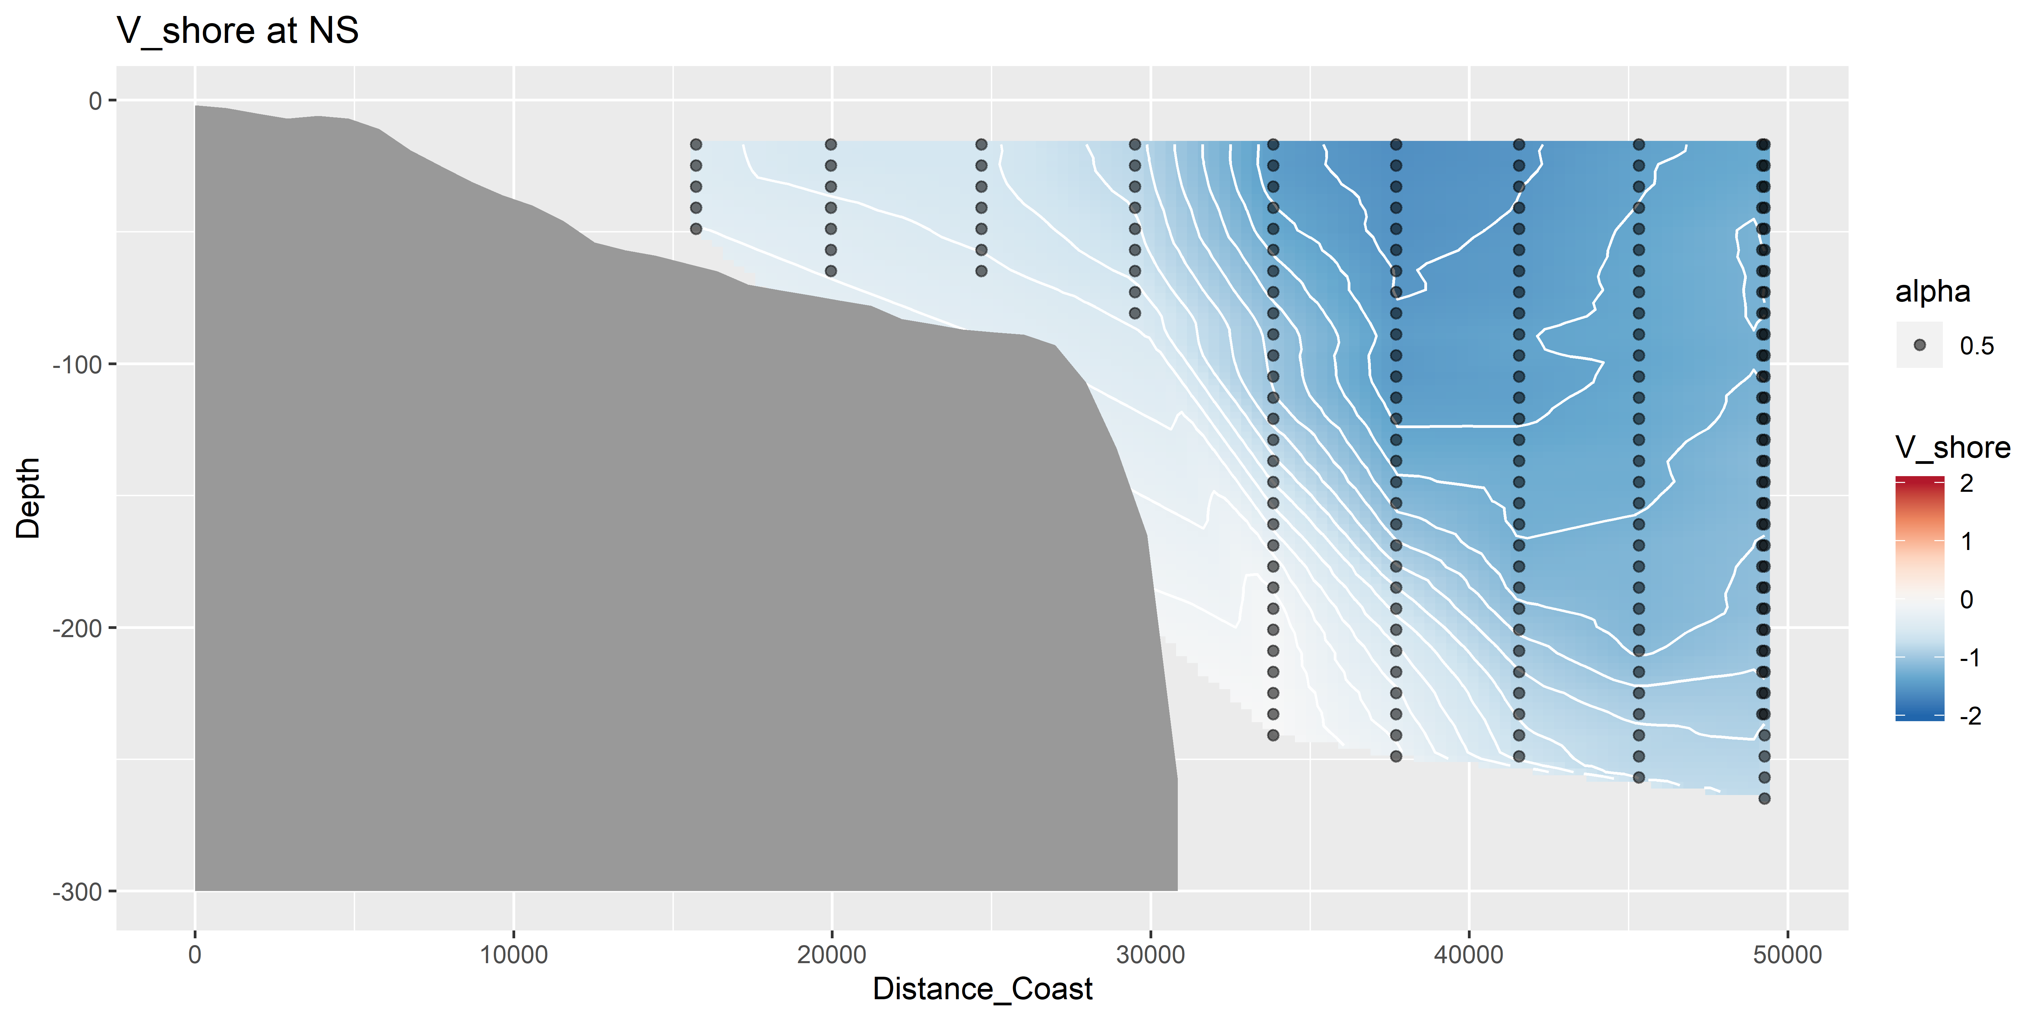
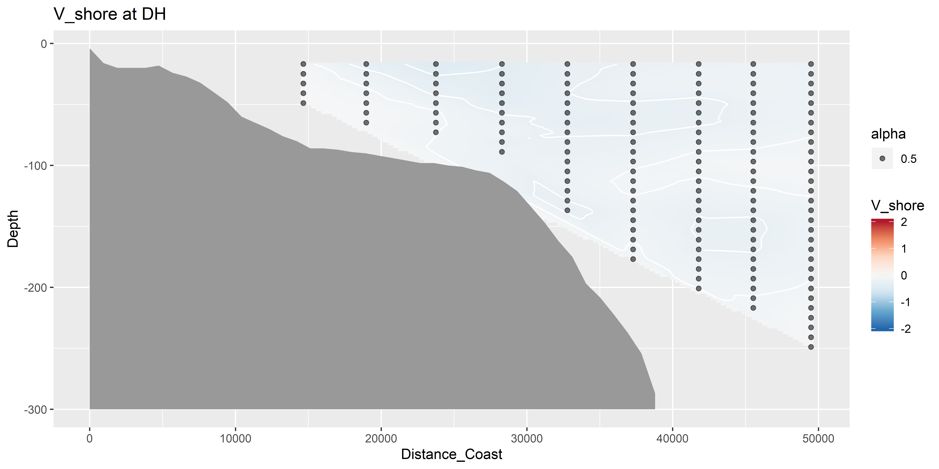
V vectors – shoreline rotated (m s⁻¹)

Slide 9
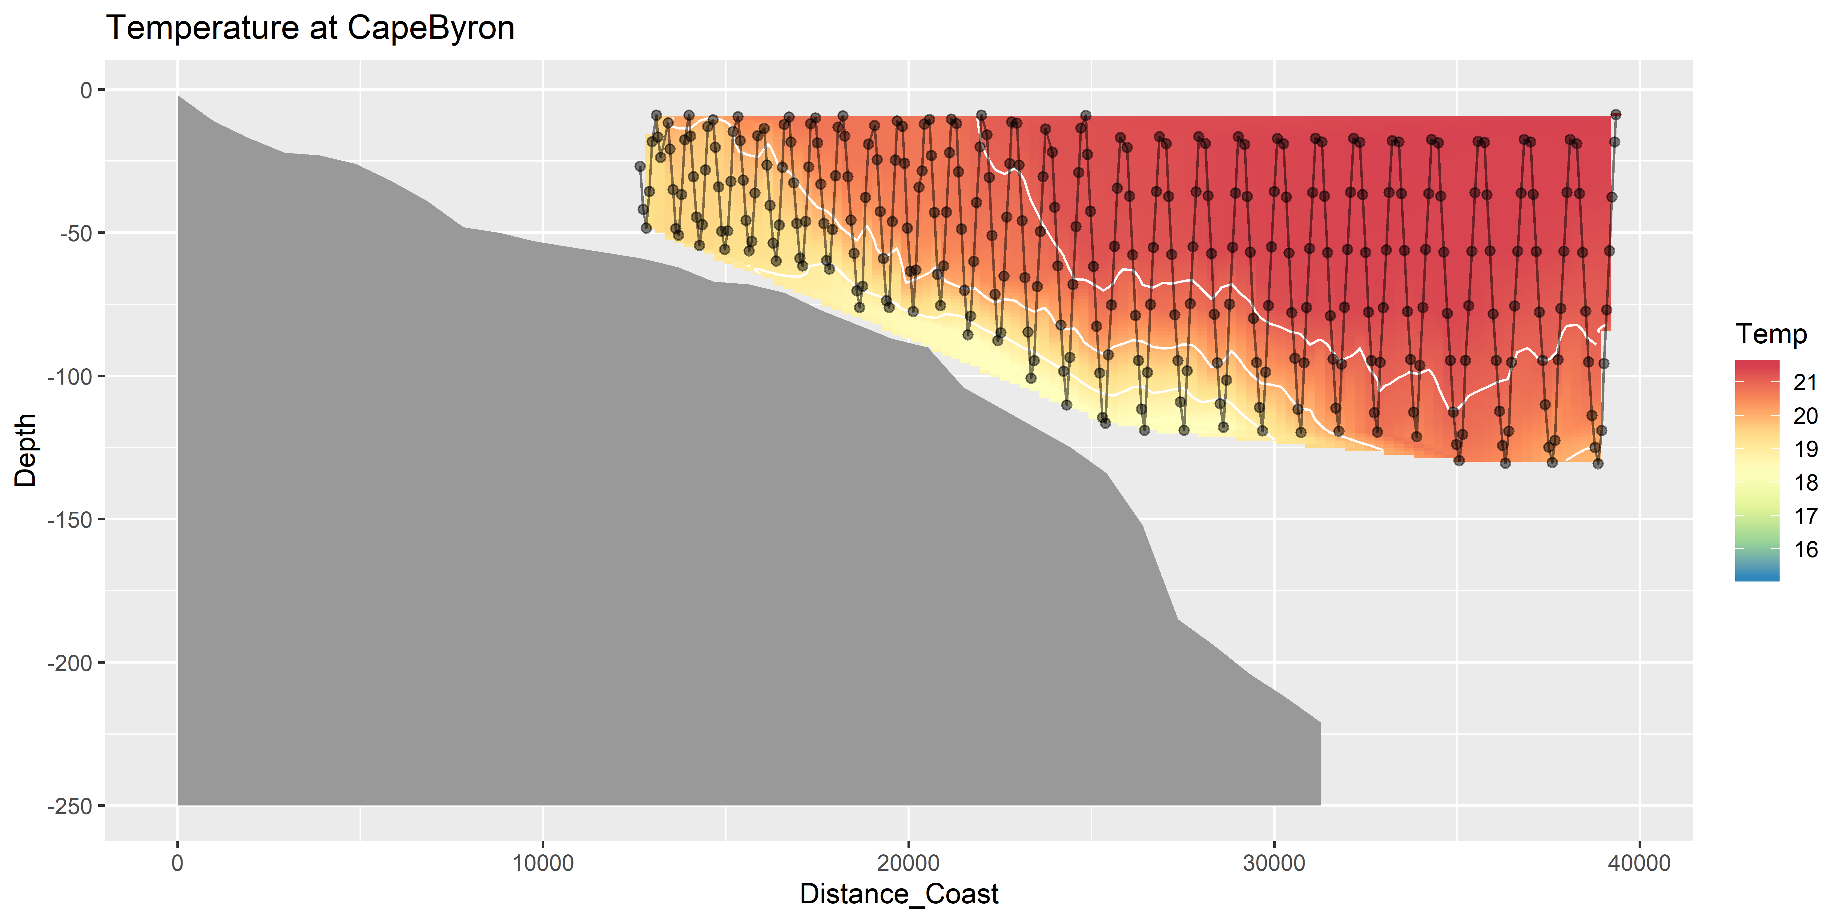
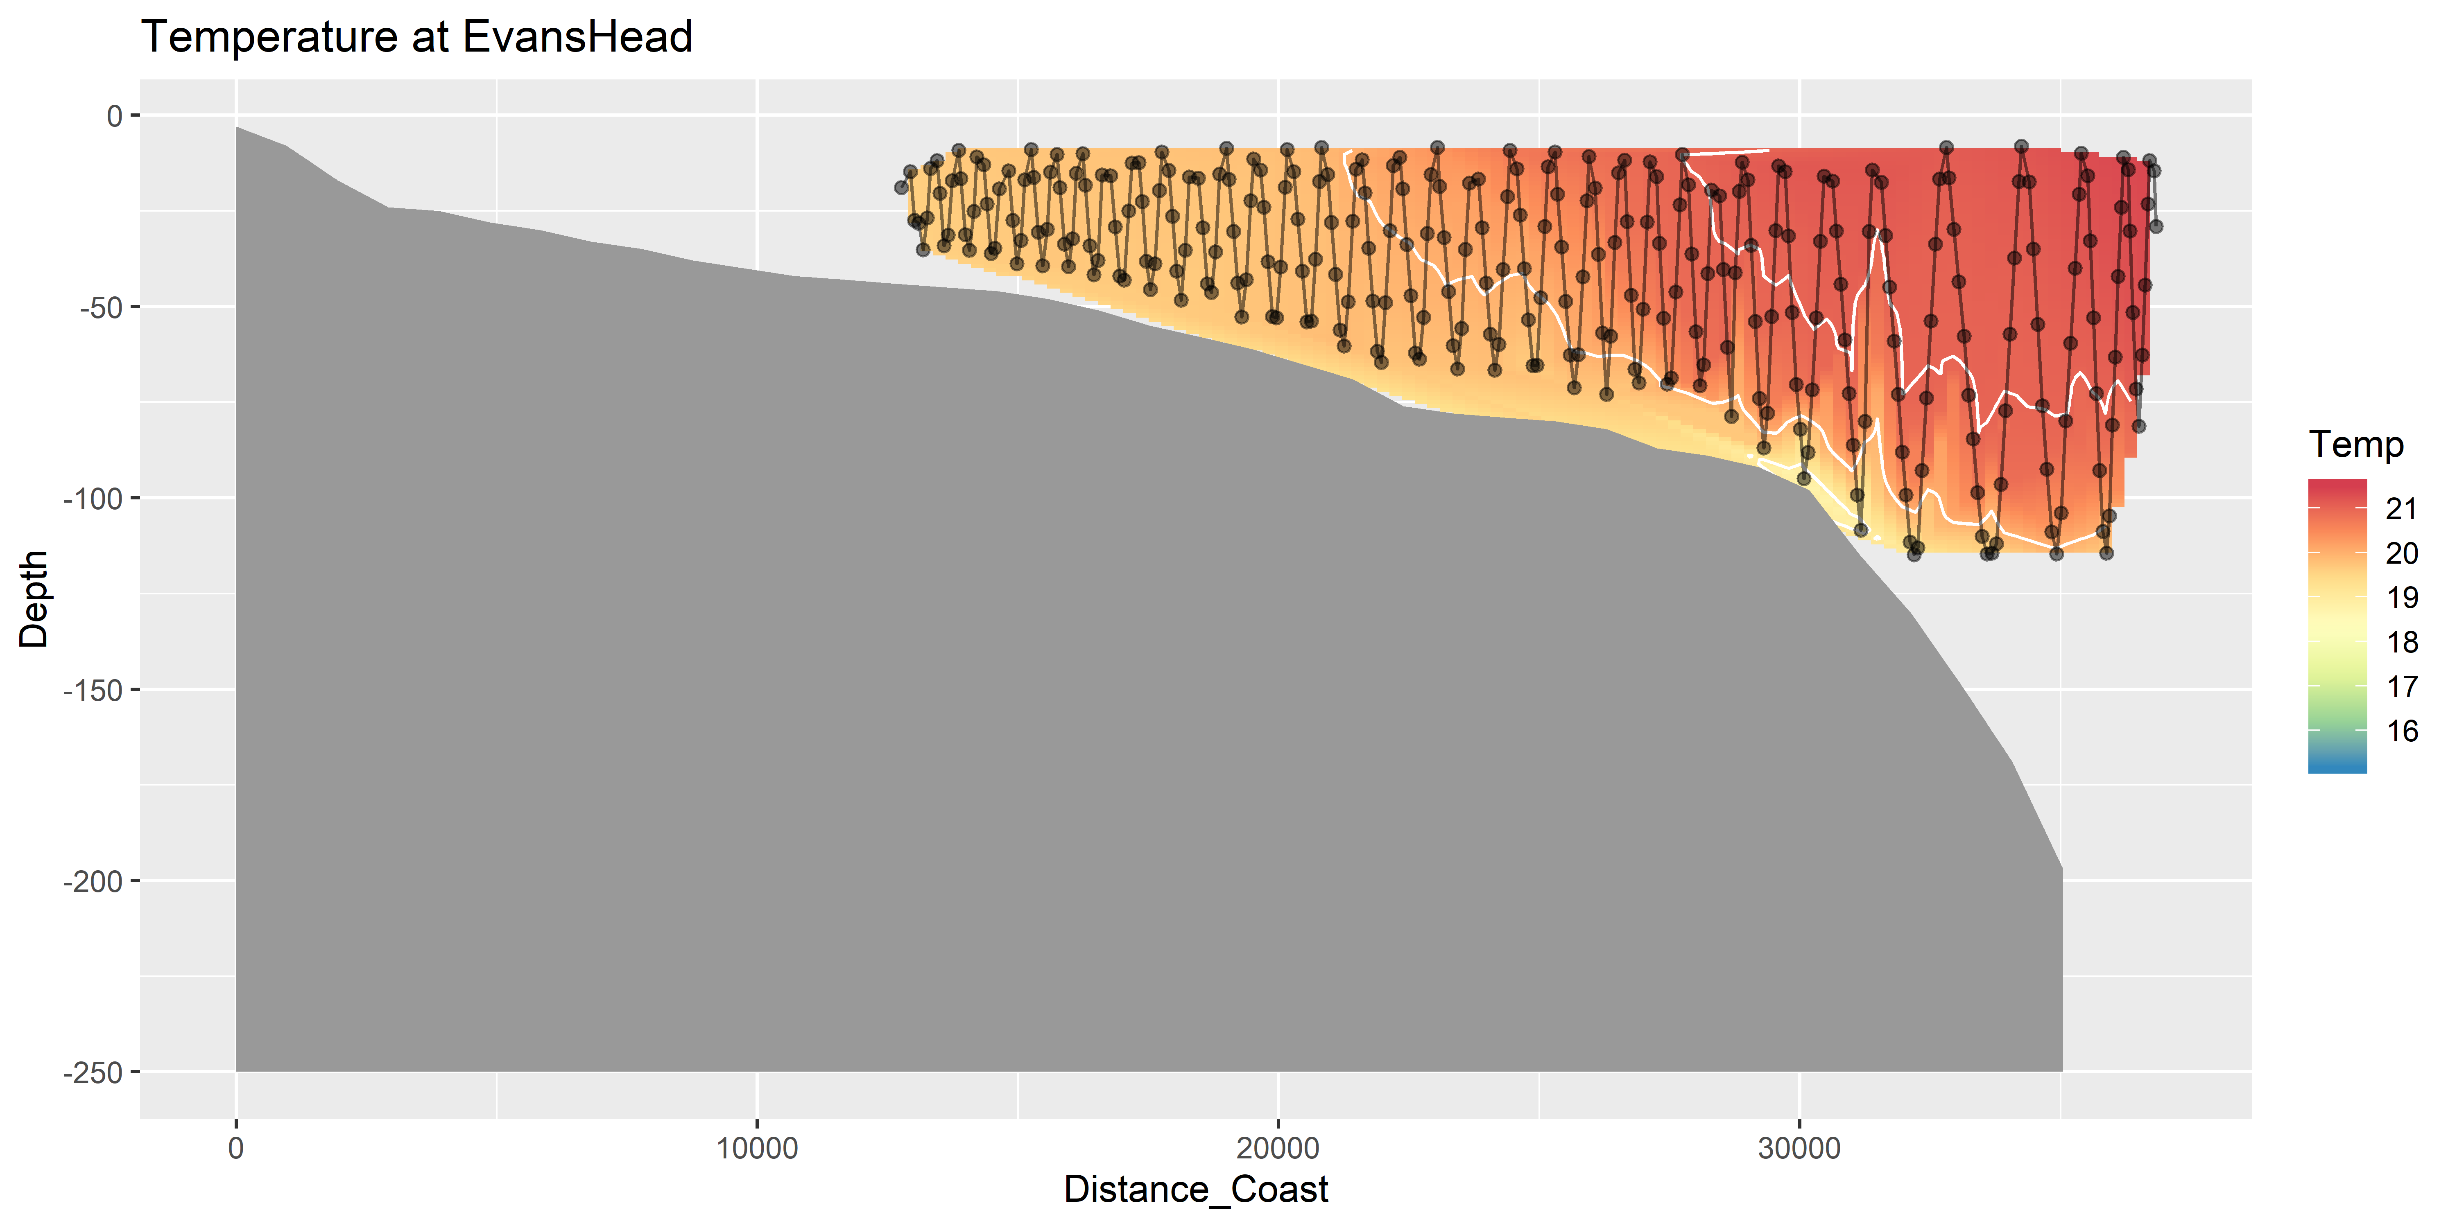
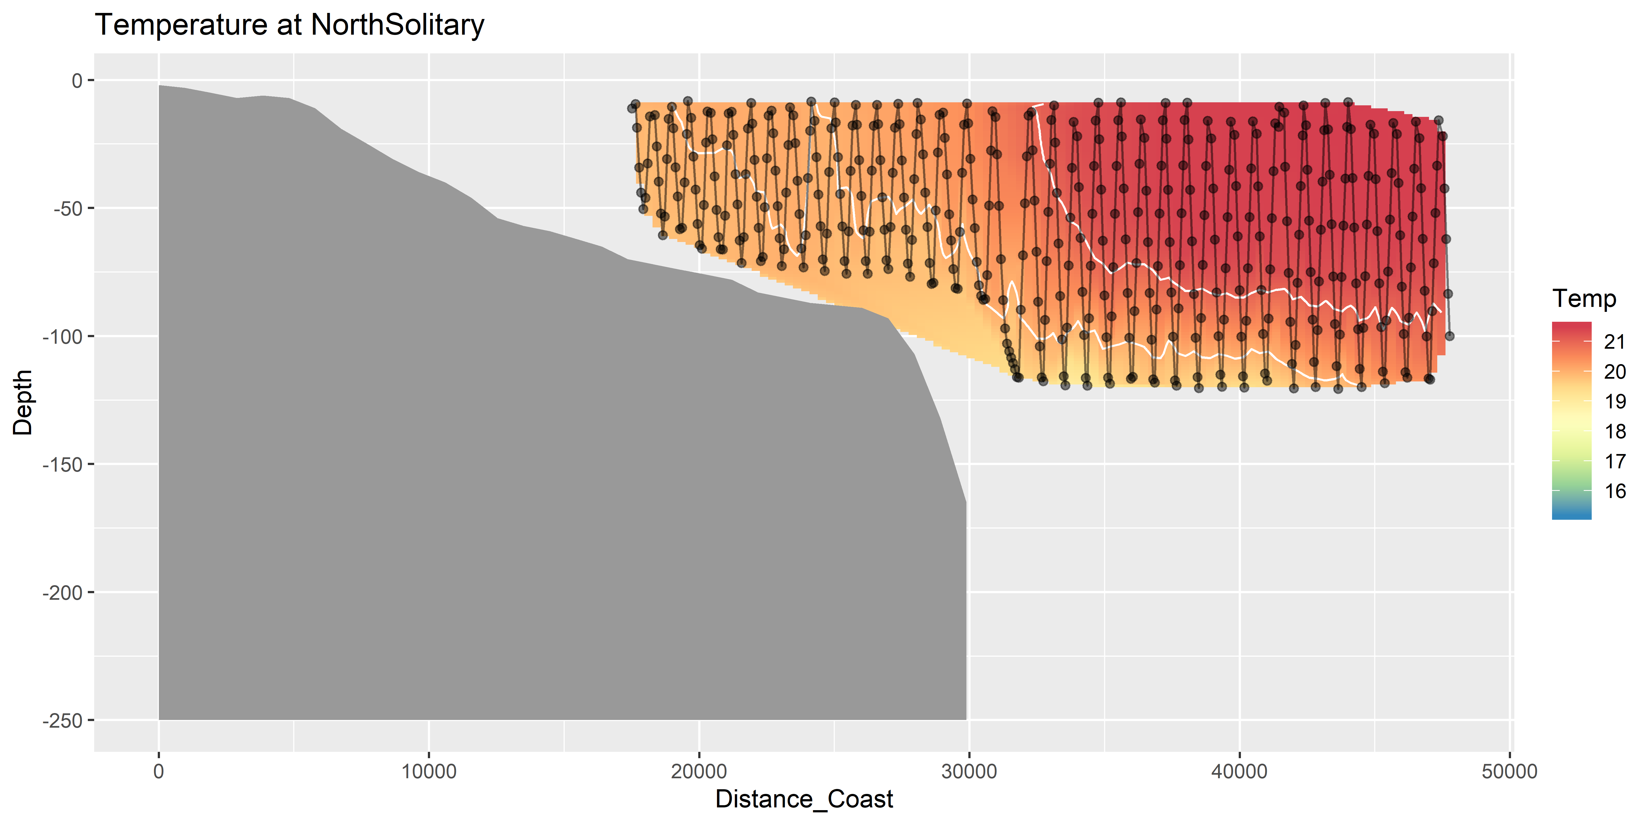
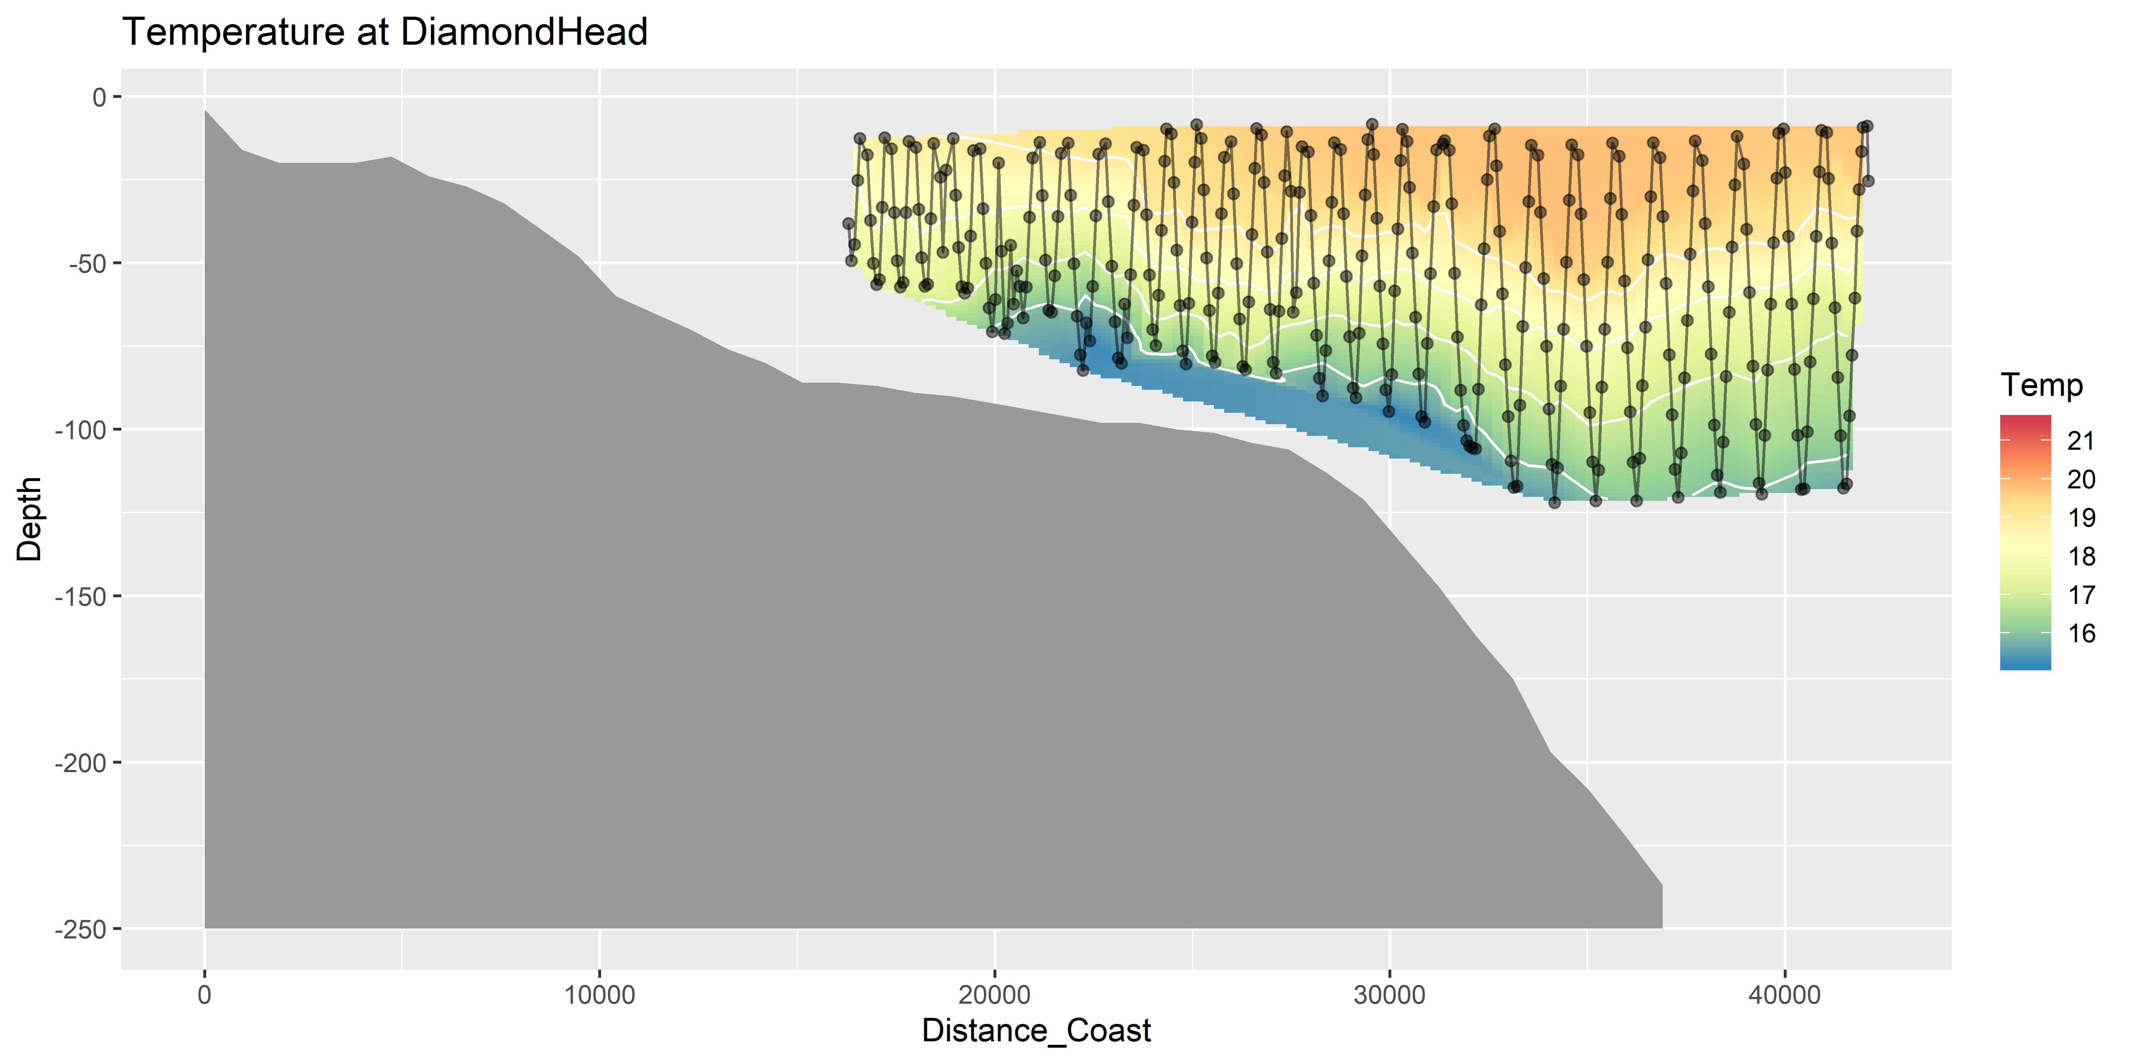
Temperature (seasoar)

Slide 10
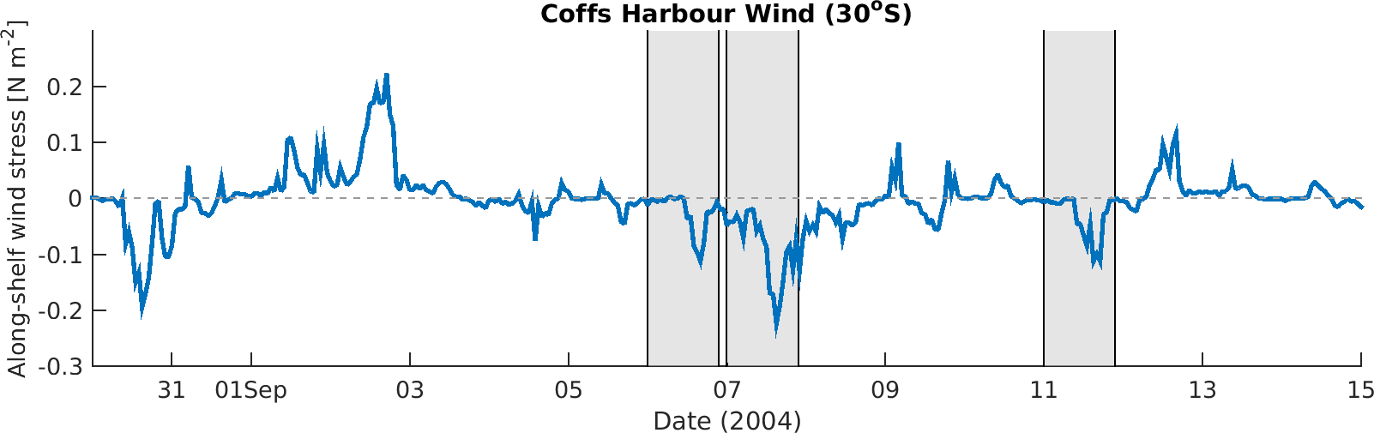
Wind Stress
DH
EH
CB

Slide 11
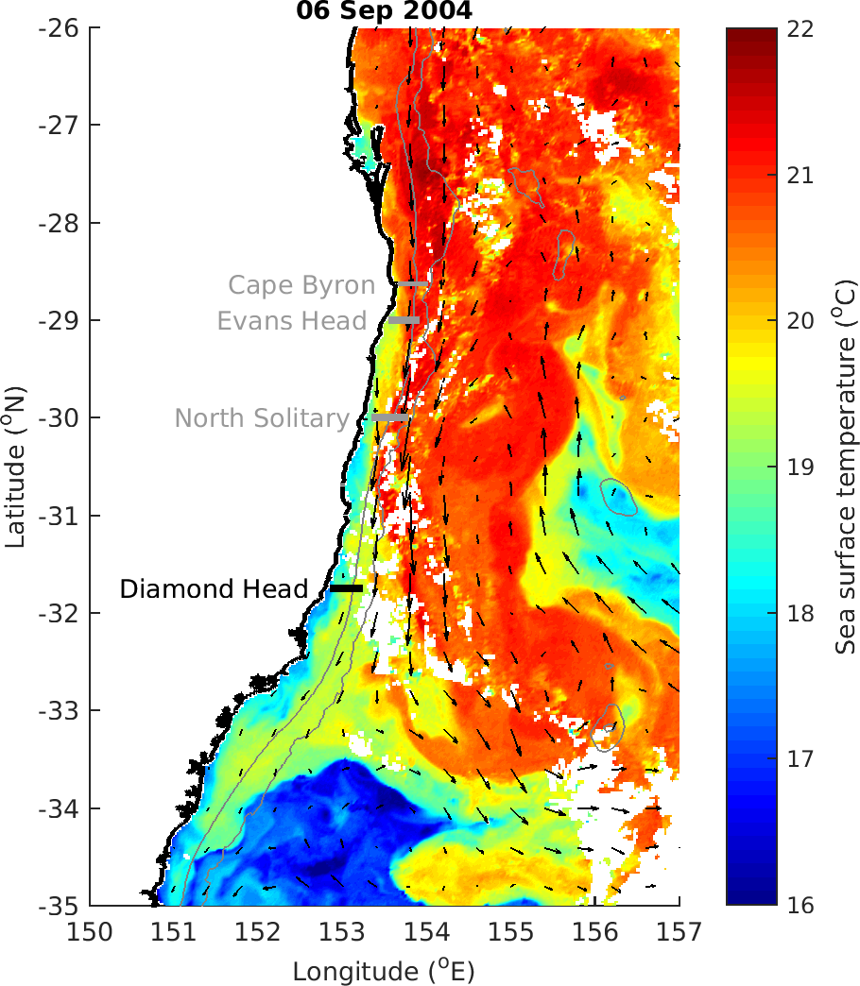

Slide 12
Zooplankton Characteristics
Biomass decreases with depth and distance from shore
Does size vary between the EAC water masses and separation zone?
Largest particles near shore at Diamond Head, due to separation and different water?
Slope does not appear to consistently approach -1 in offshore water (theoretical expectation)
Vandromme showed shallower slope offshore (-1 → -0.4; SW France)

Slide 13
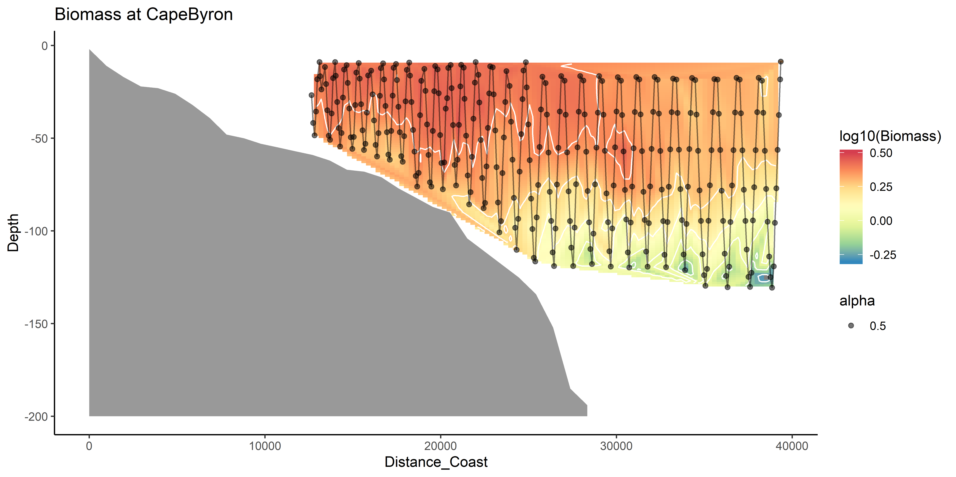
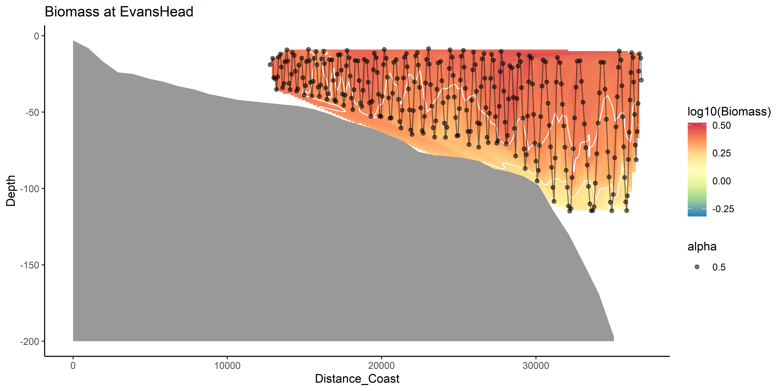
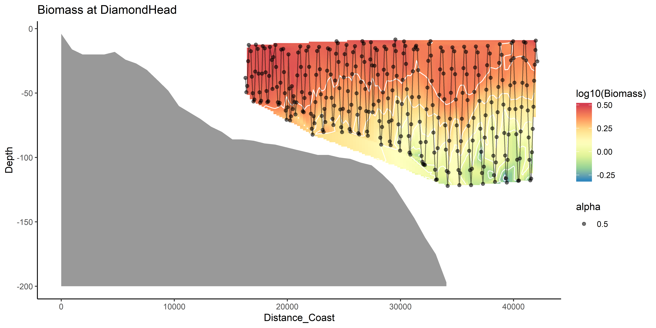
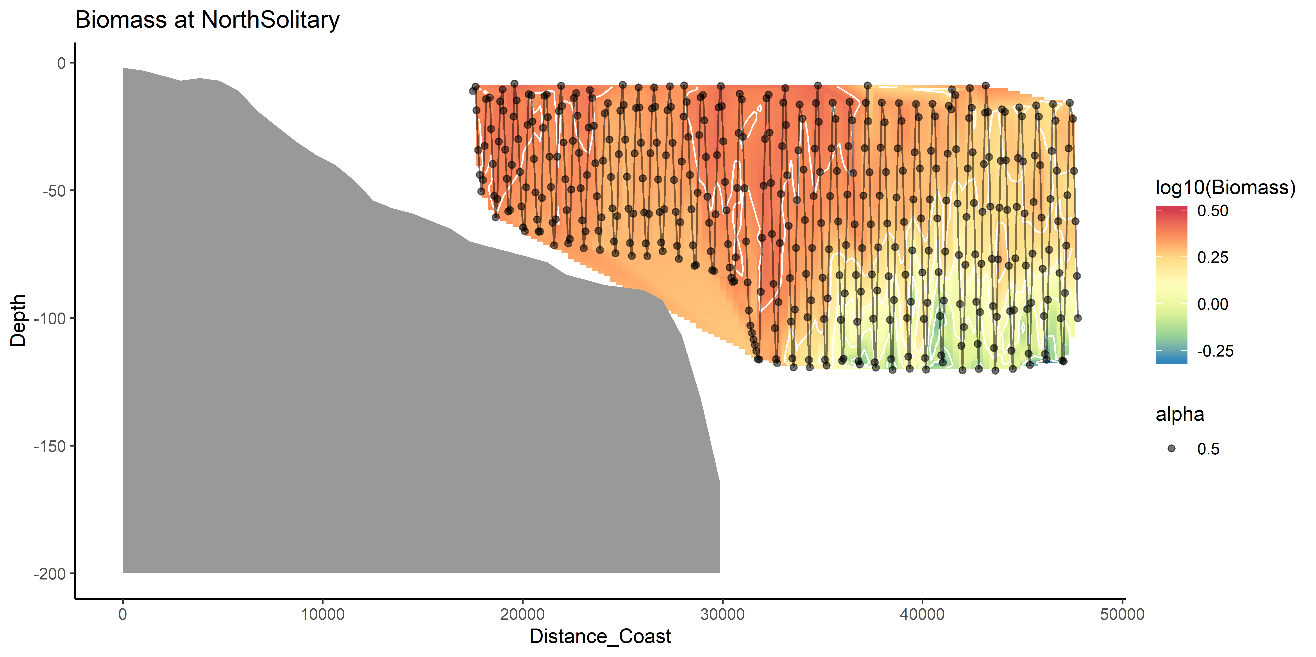
Zooplankton Biomass

Slide 14
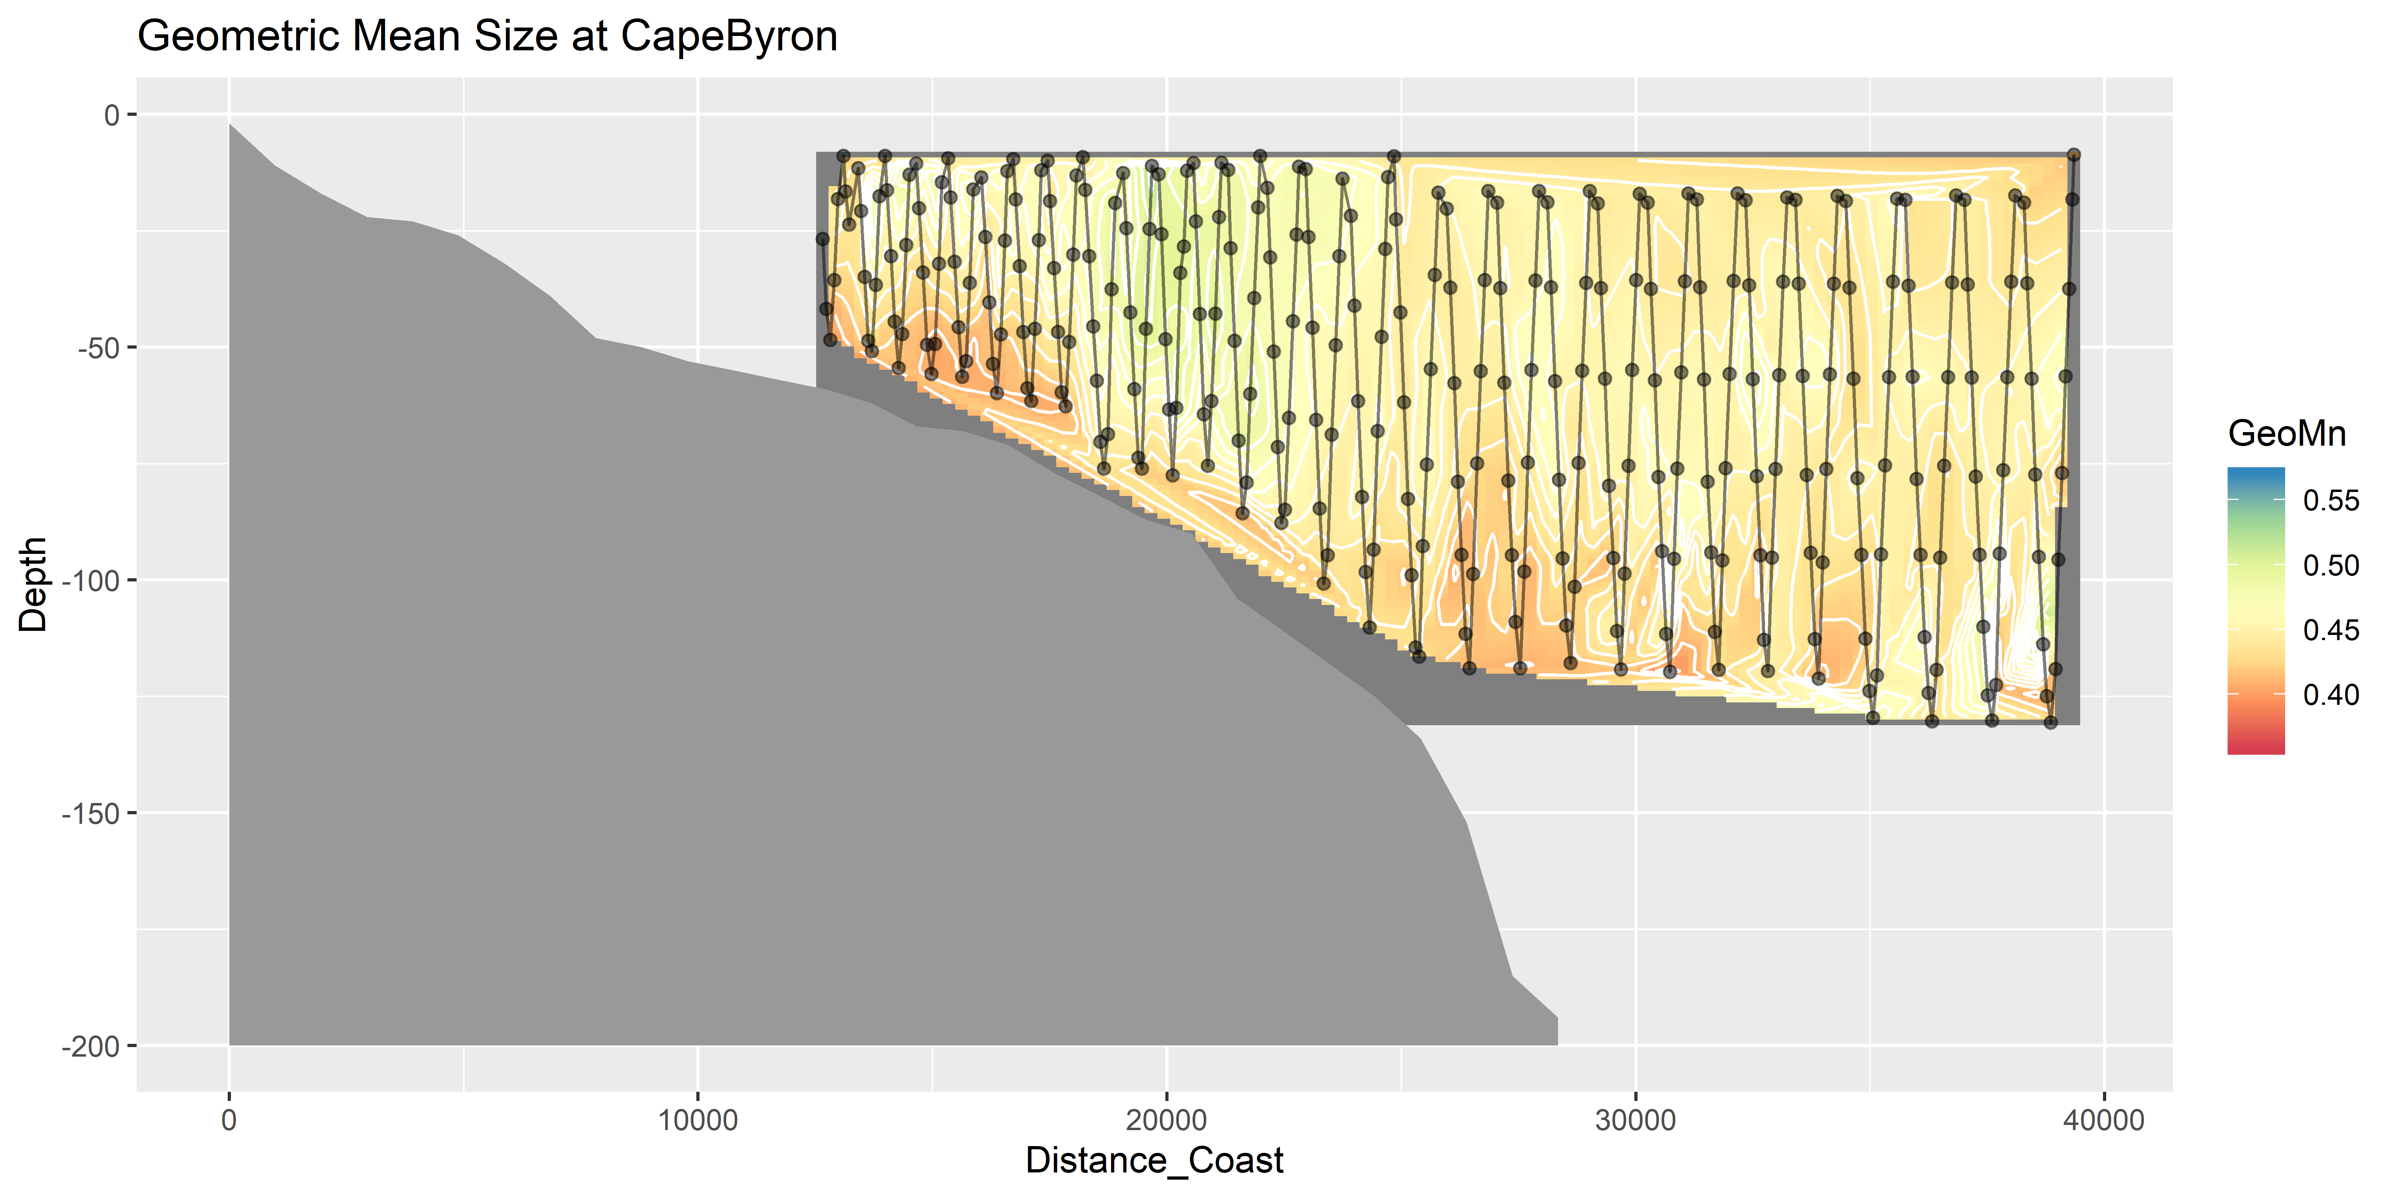
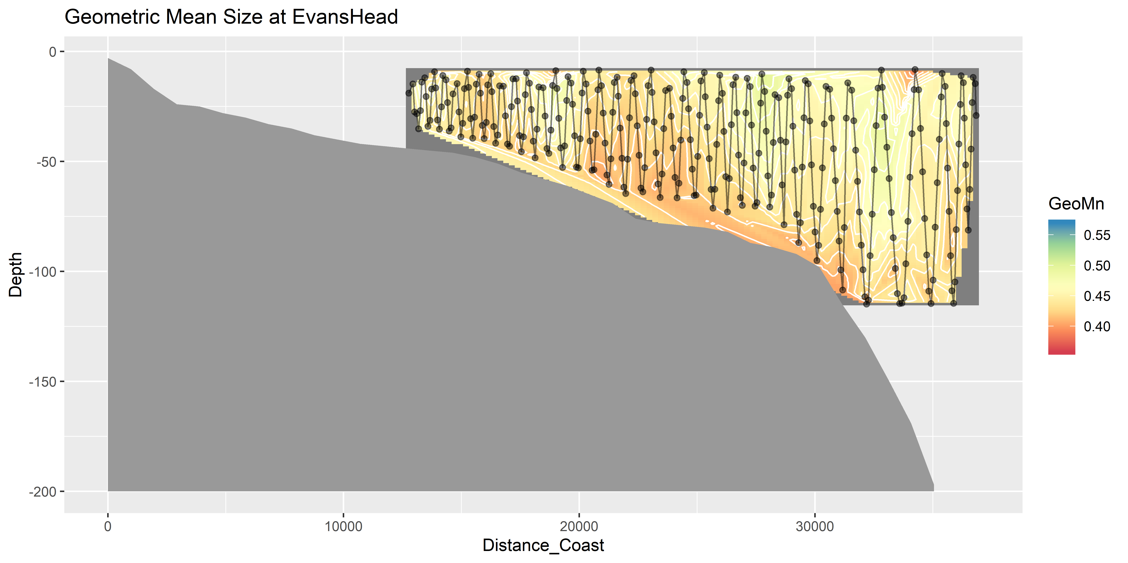
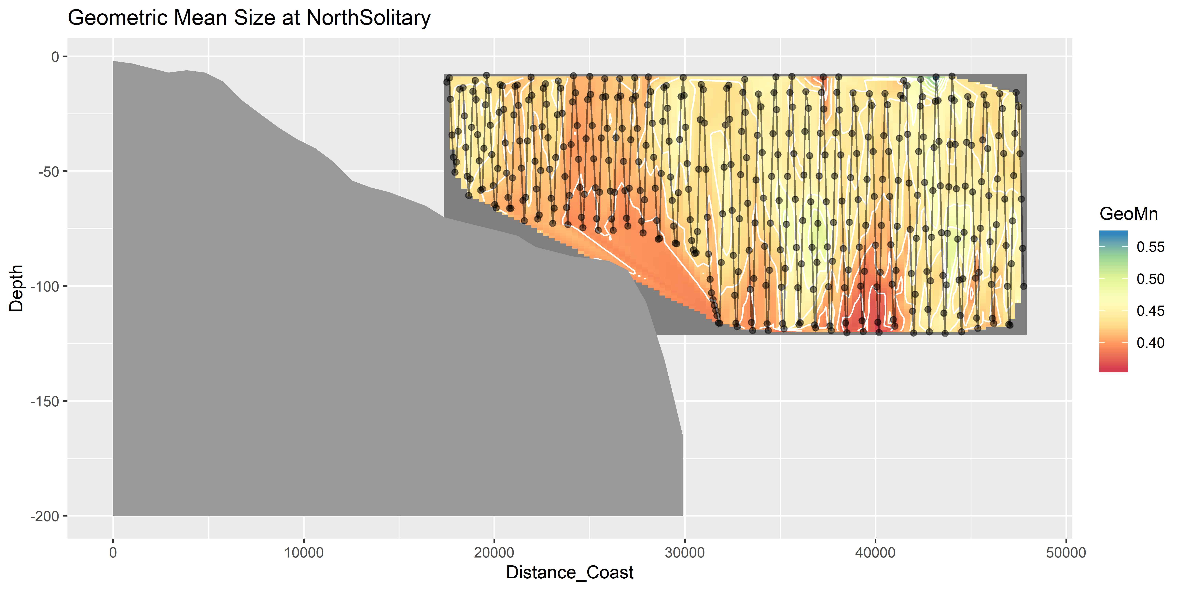
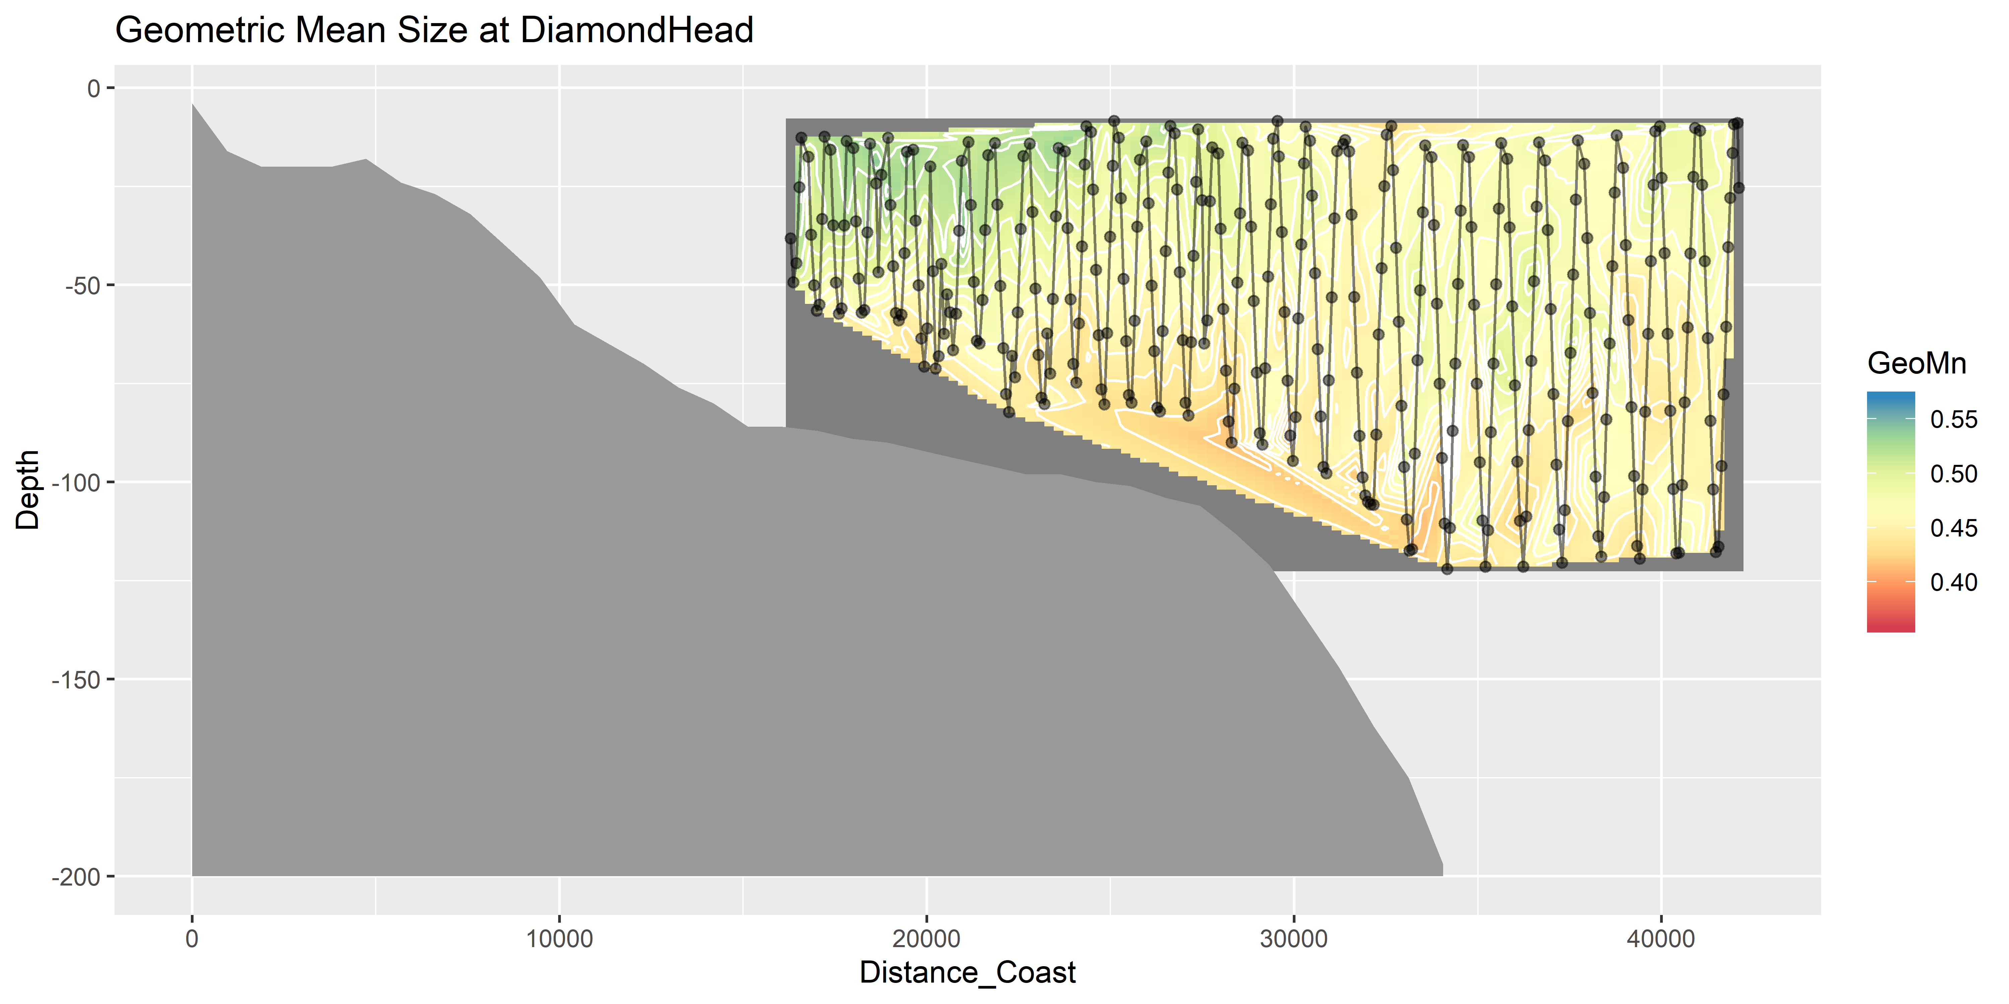
Geometric Mean Size

Slide 15
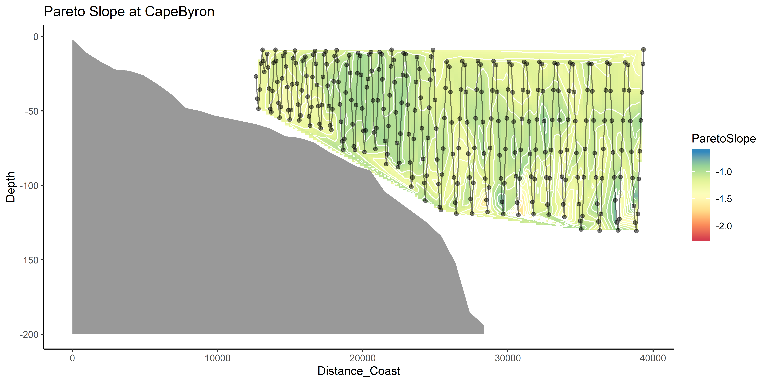
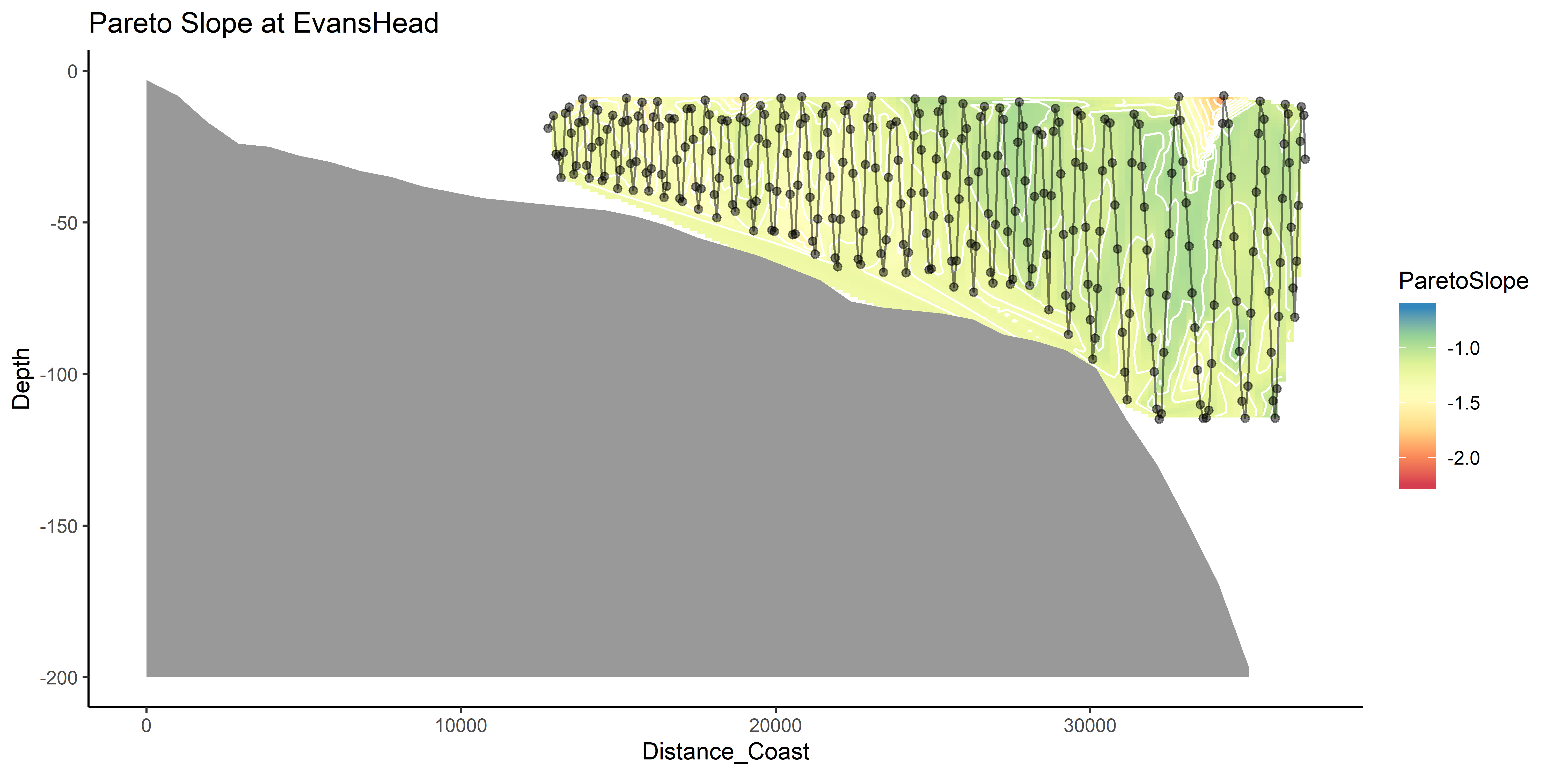
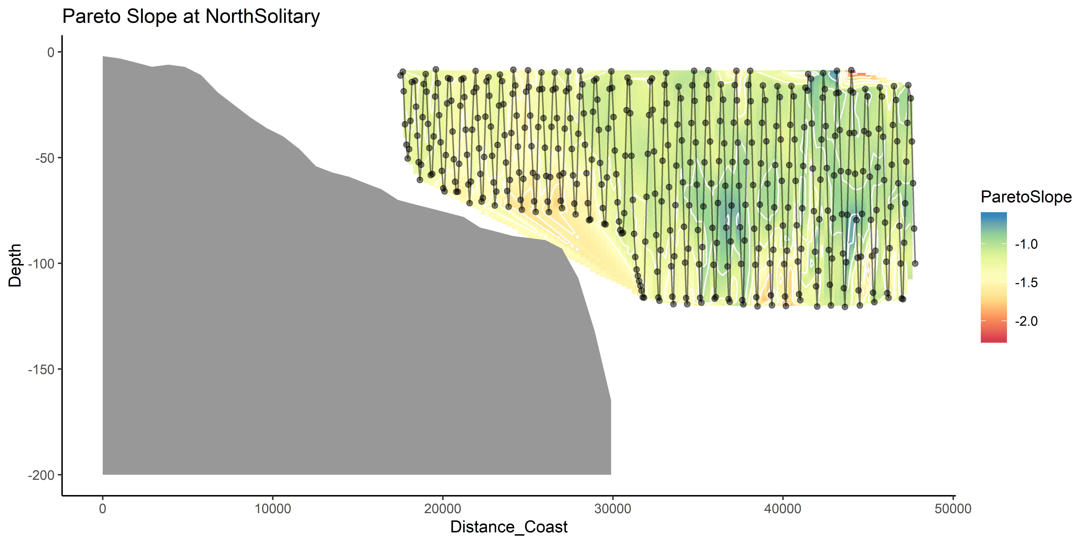
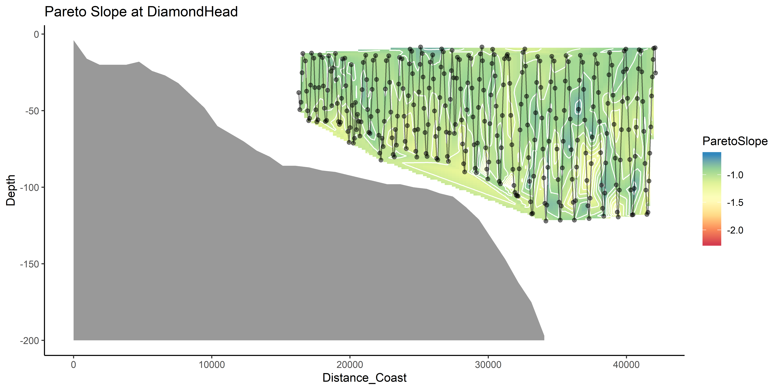
Pareto Slope

Slide 16
Linking water and zooplankton
Temp + Salt highly correlated (0.93)
Temp + Depth slight neg. cor. (-0.3)
Temp + Distance_Coast slight pos. cor (0.24)
Longitude + Distance_Coast slight pos. cor (0.09)
Moran’s I value = 0.33 (Biomass)
Moran’s I value = 0.29 (Pareto Slope)

Slide 17
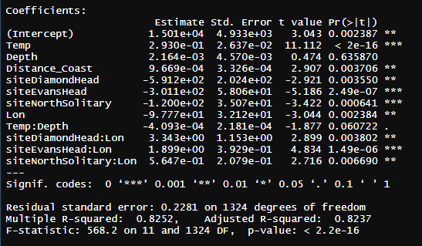
Zooplankton Biomass models
log10(Biomass) ~ Temp * Depth + Distance_Coast + site * Lon, data = mydataX)

Slide 18
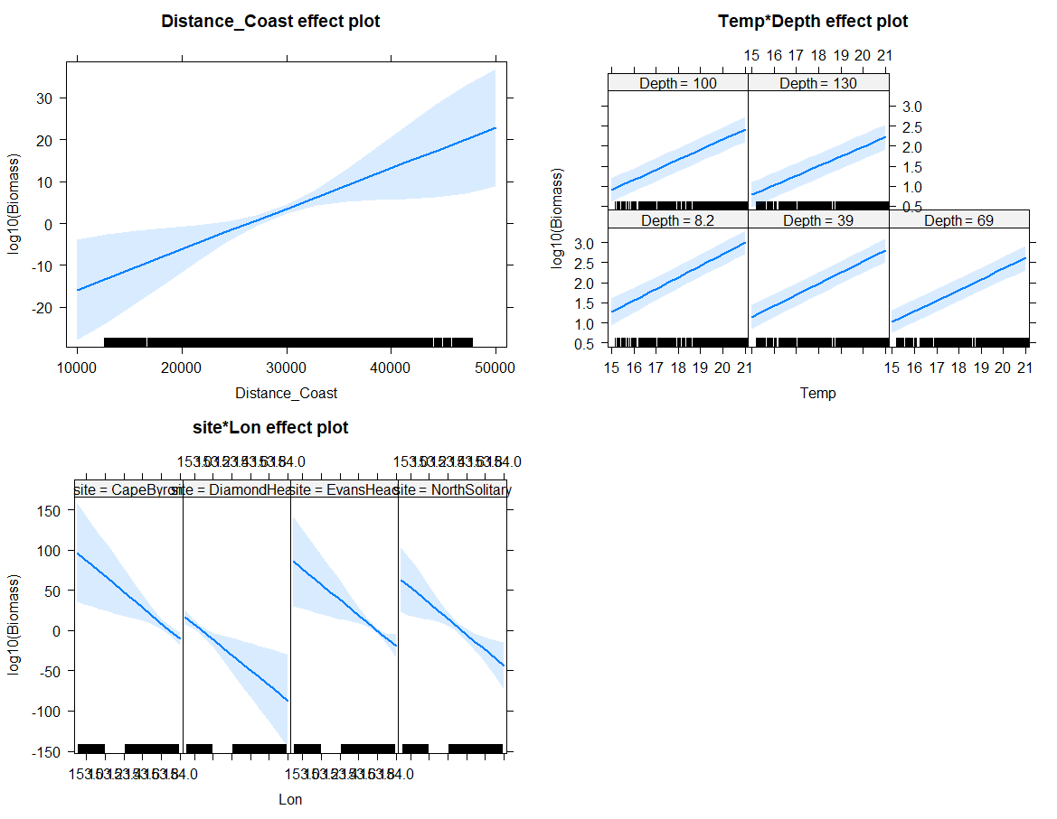

Slide 19
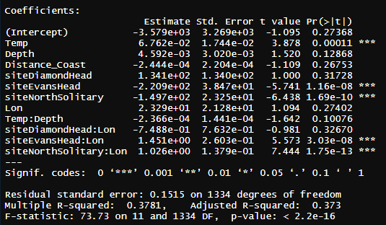
Pareto Slope Model
ParetoSlope ~ Temp * Depth + Distance_Coast + site * Lon

Slide 20
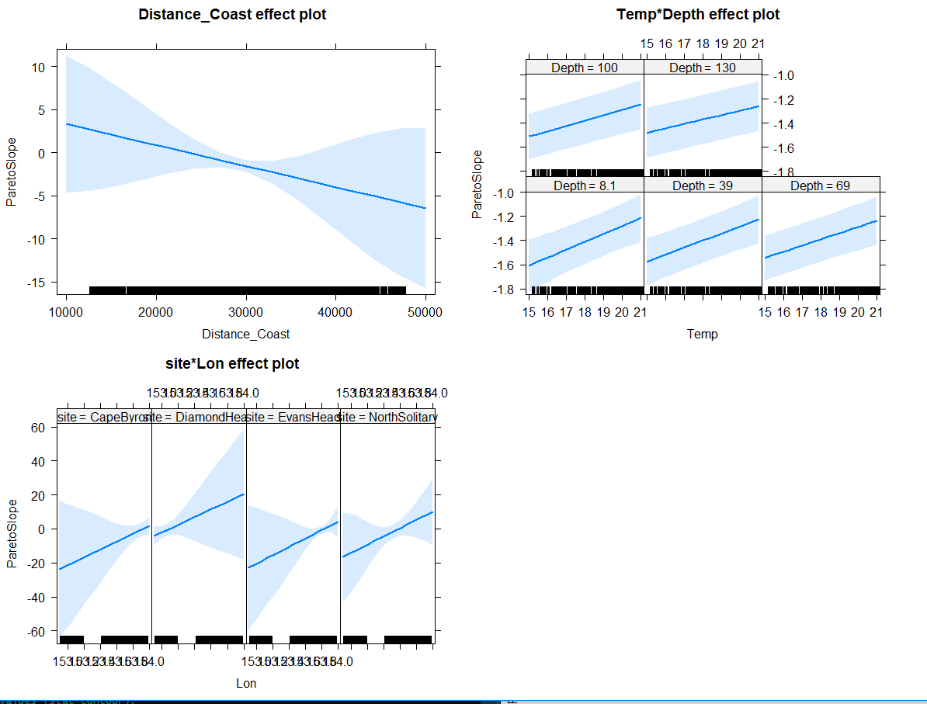

Slide 21
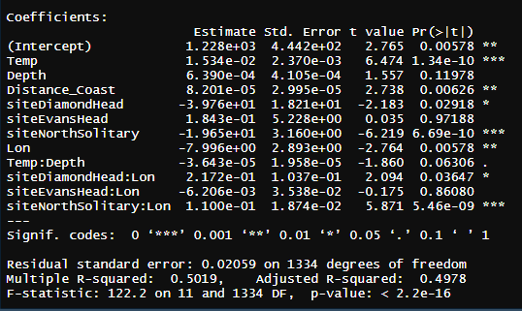
GeoMn Size
GeoMn*1000 ~ Temp * Depth + Distance_Coast + site * Lon, data = mydata

Slide 22
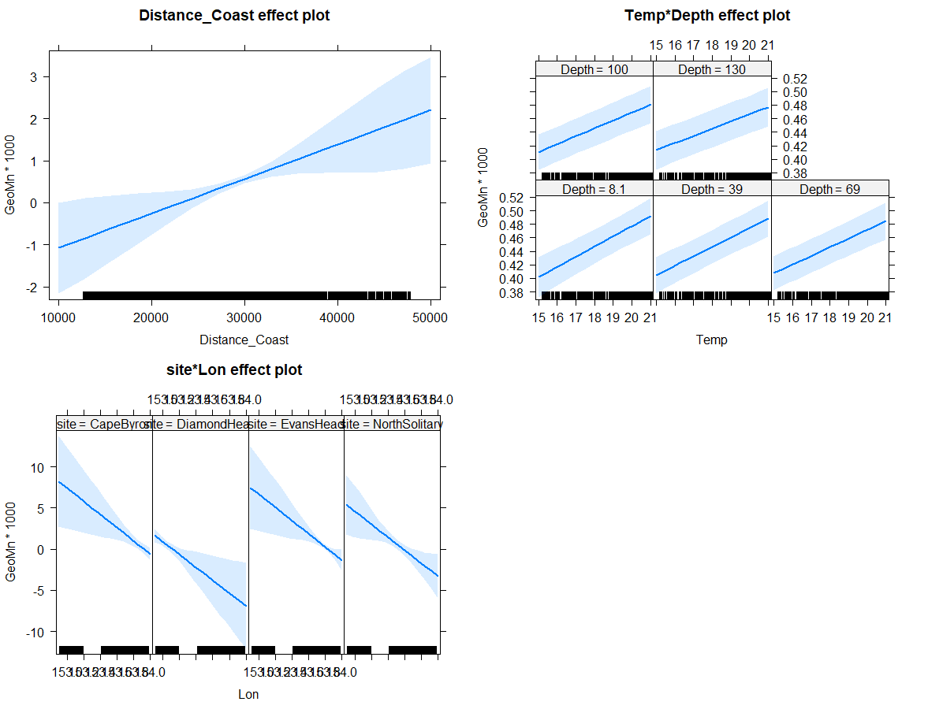

Slide 23
Larger context (not for today)
How typical are the observations seen in these transects?
Temp and Sal
Chl-a
IMOS NRS Moorings
Gliders
Satellite data

Slide 25
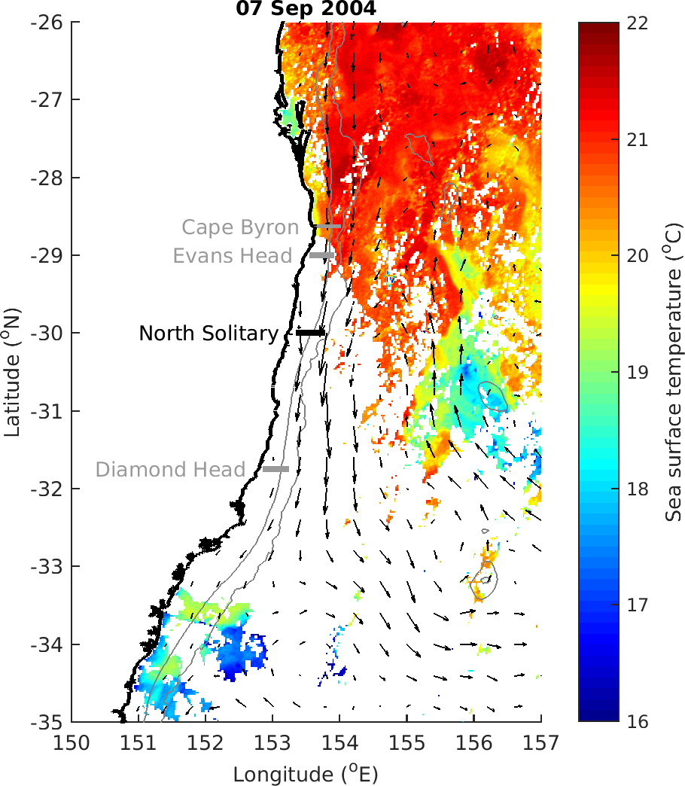

Slide 26
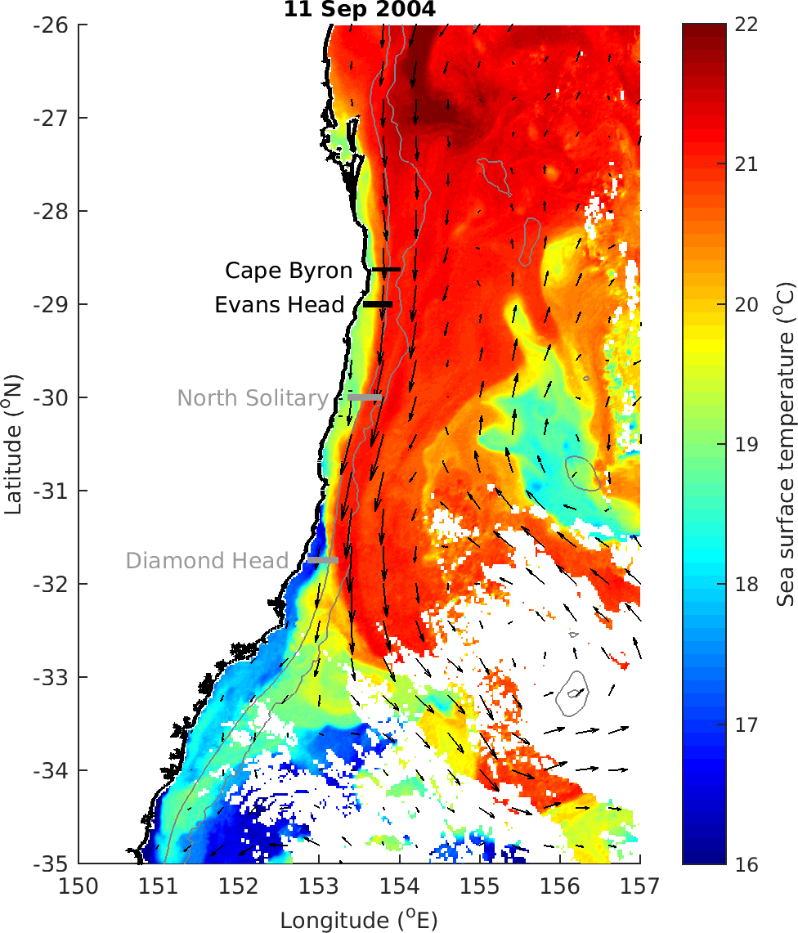

Slide 27
MODIS Chl_a

Slide 28
T-S Plot all depths (CTD)

Slide 29
TS Plot by log₁₀(Biomass)

Slide 30
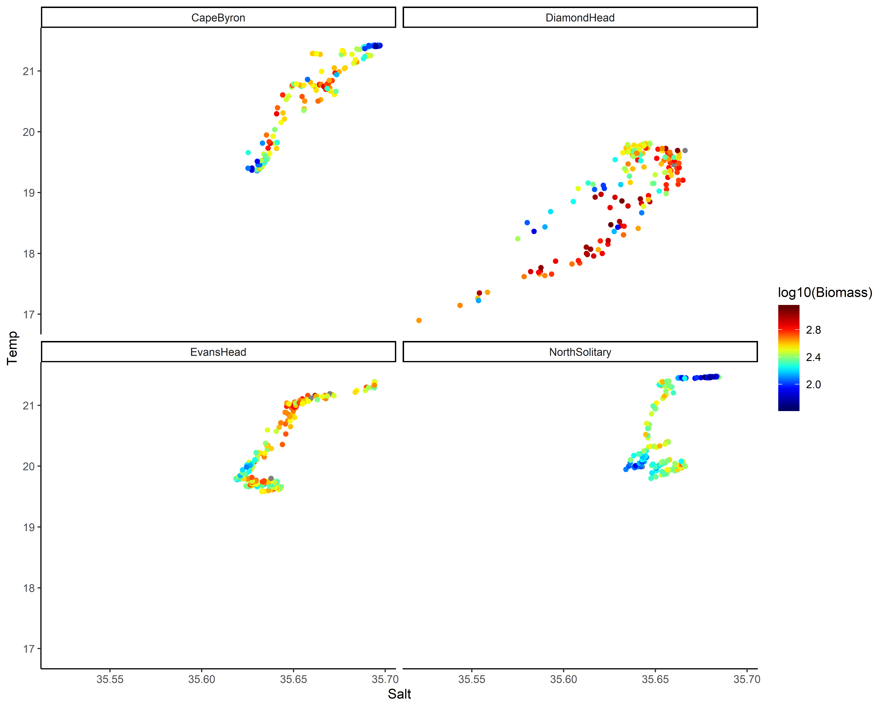
TS Plot by log₁₀(Biomass) top 50m

Slide 31
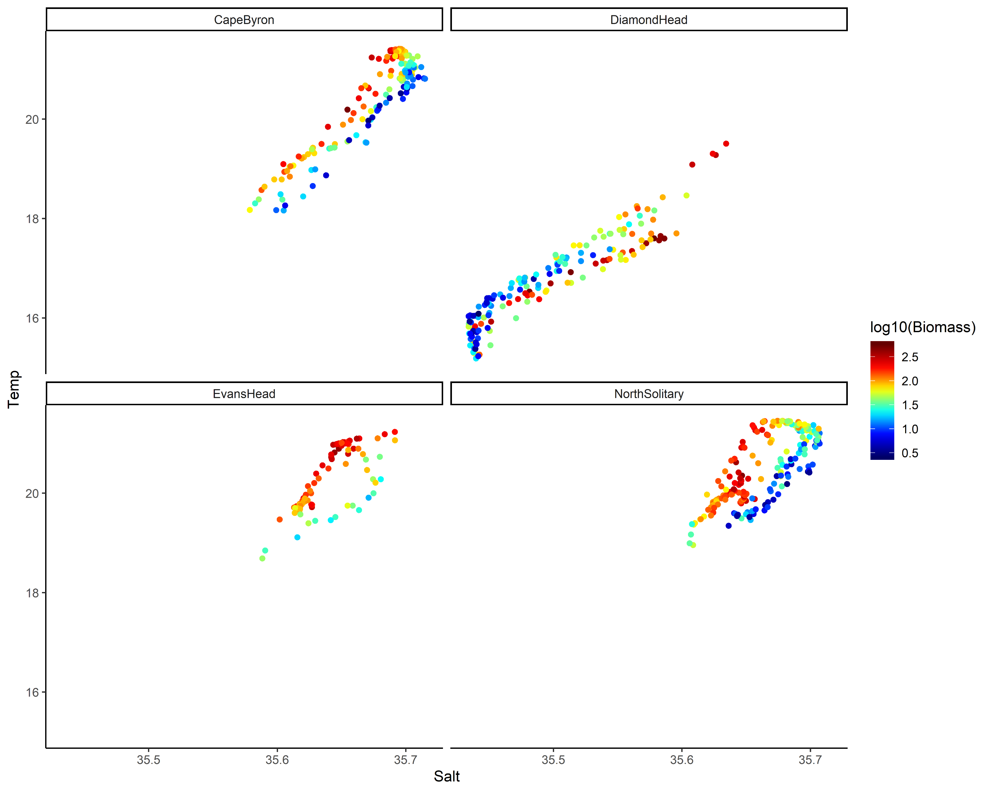
TS Plot by log₁₀(Biomass) below 50m

Slide 32
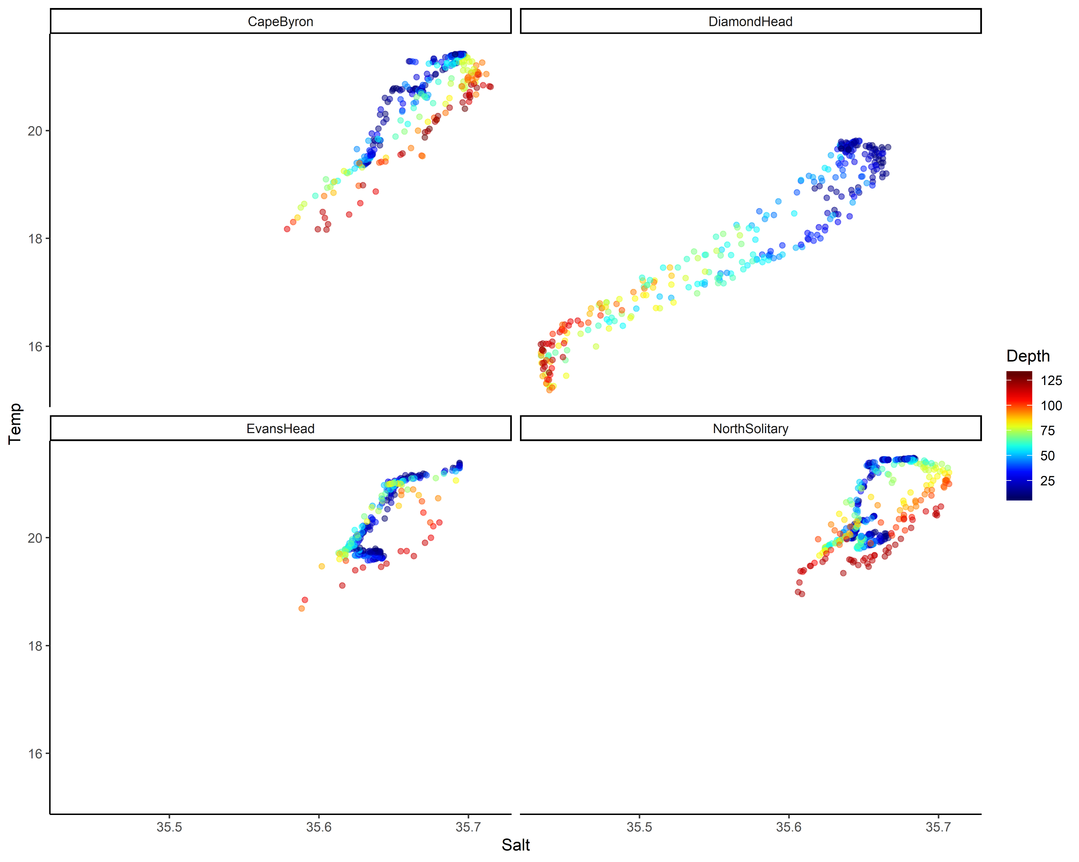
TS plot by Depth

Slide 33
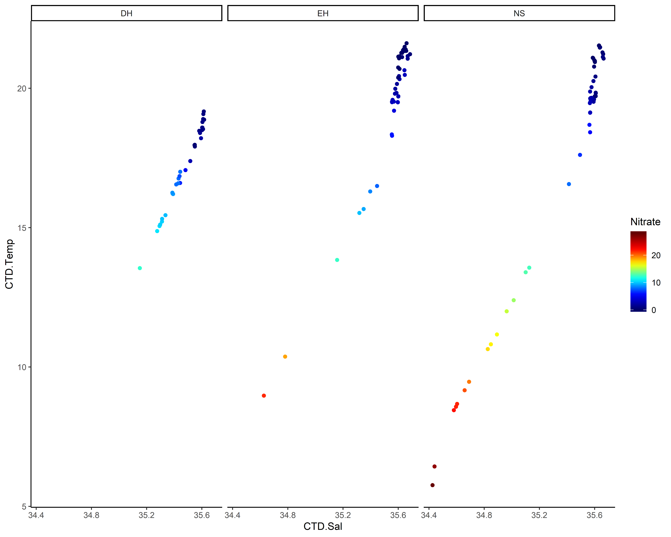
TS plot by Nitrate

Slide 34
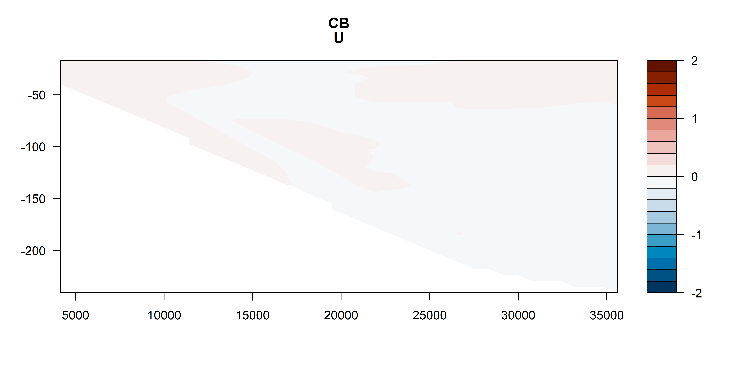
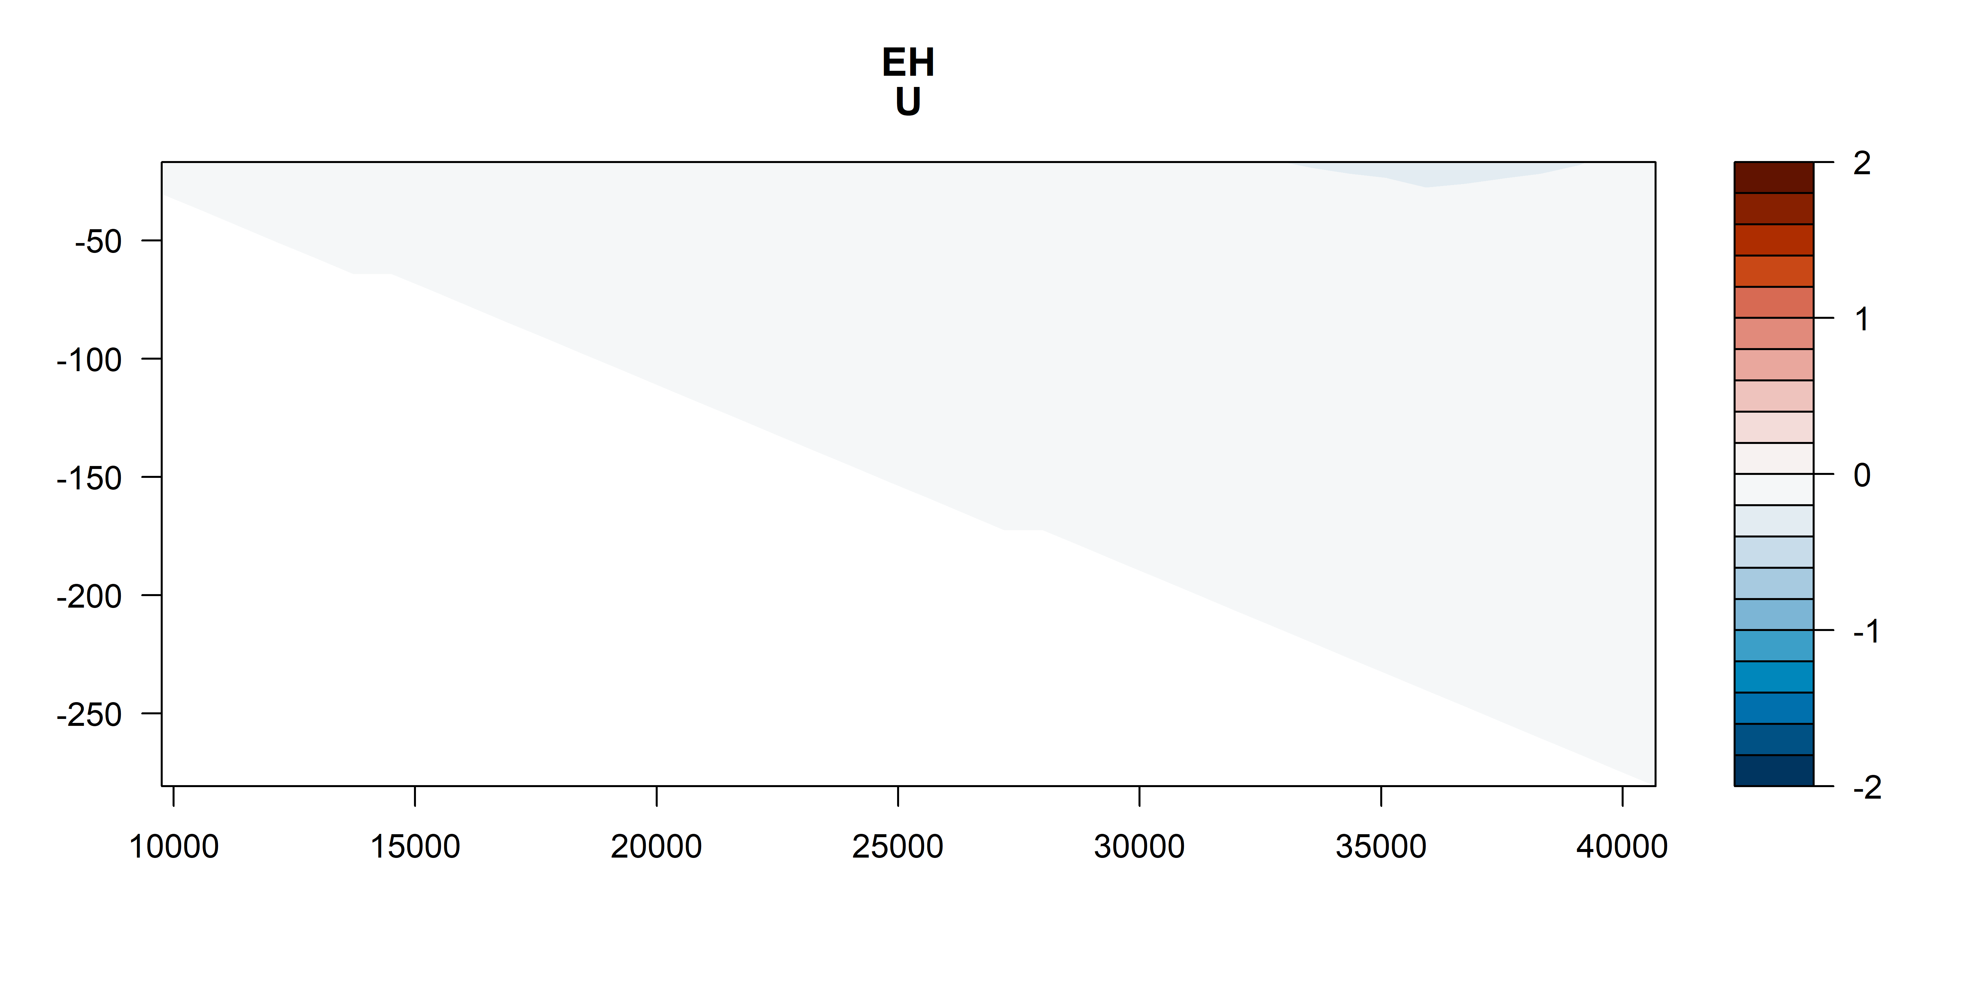
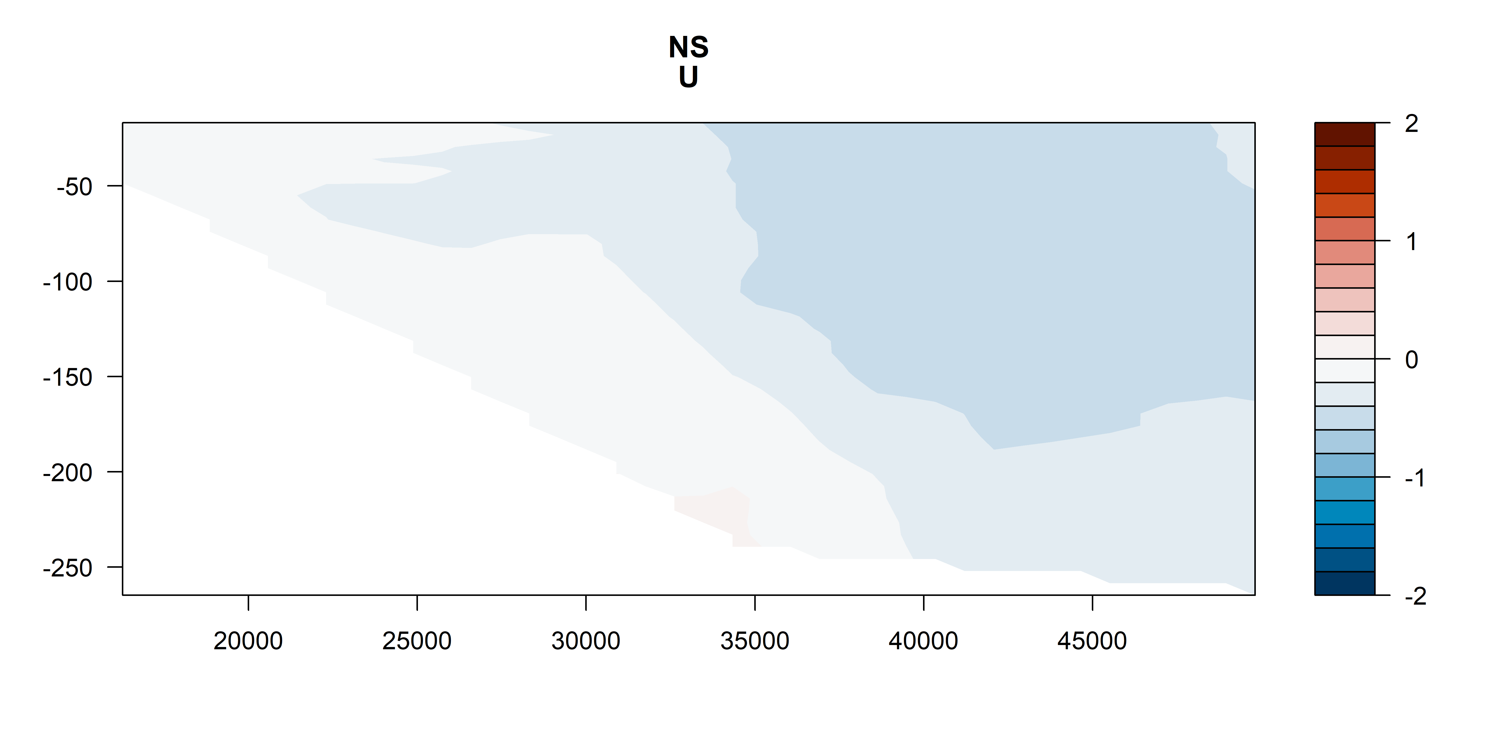
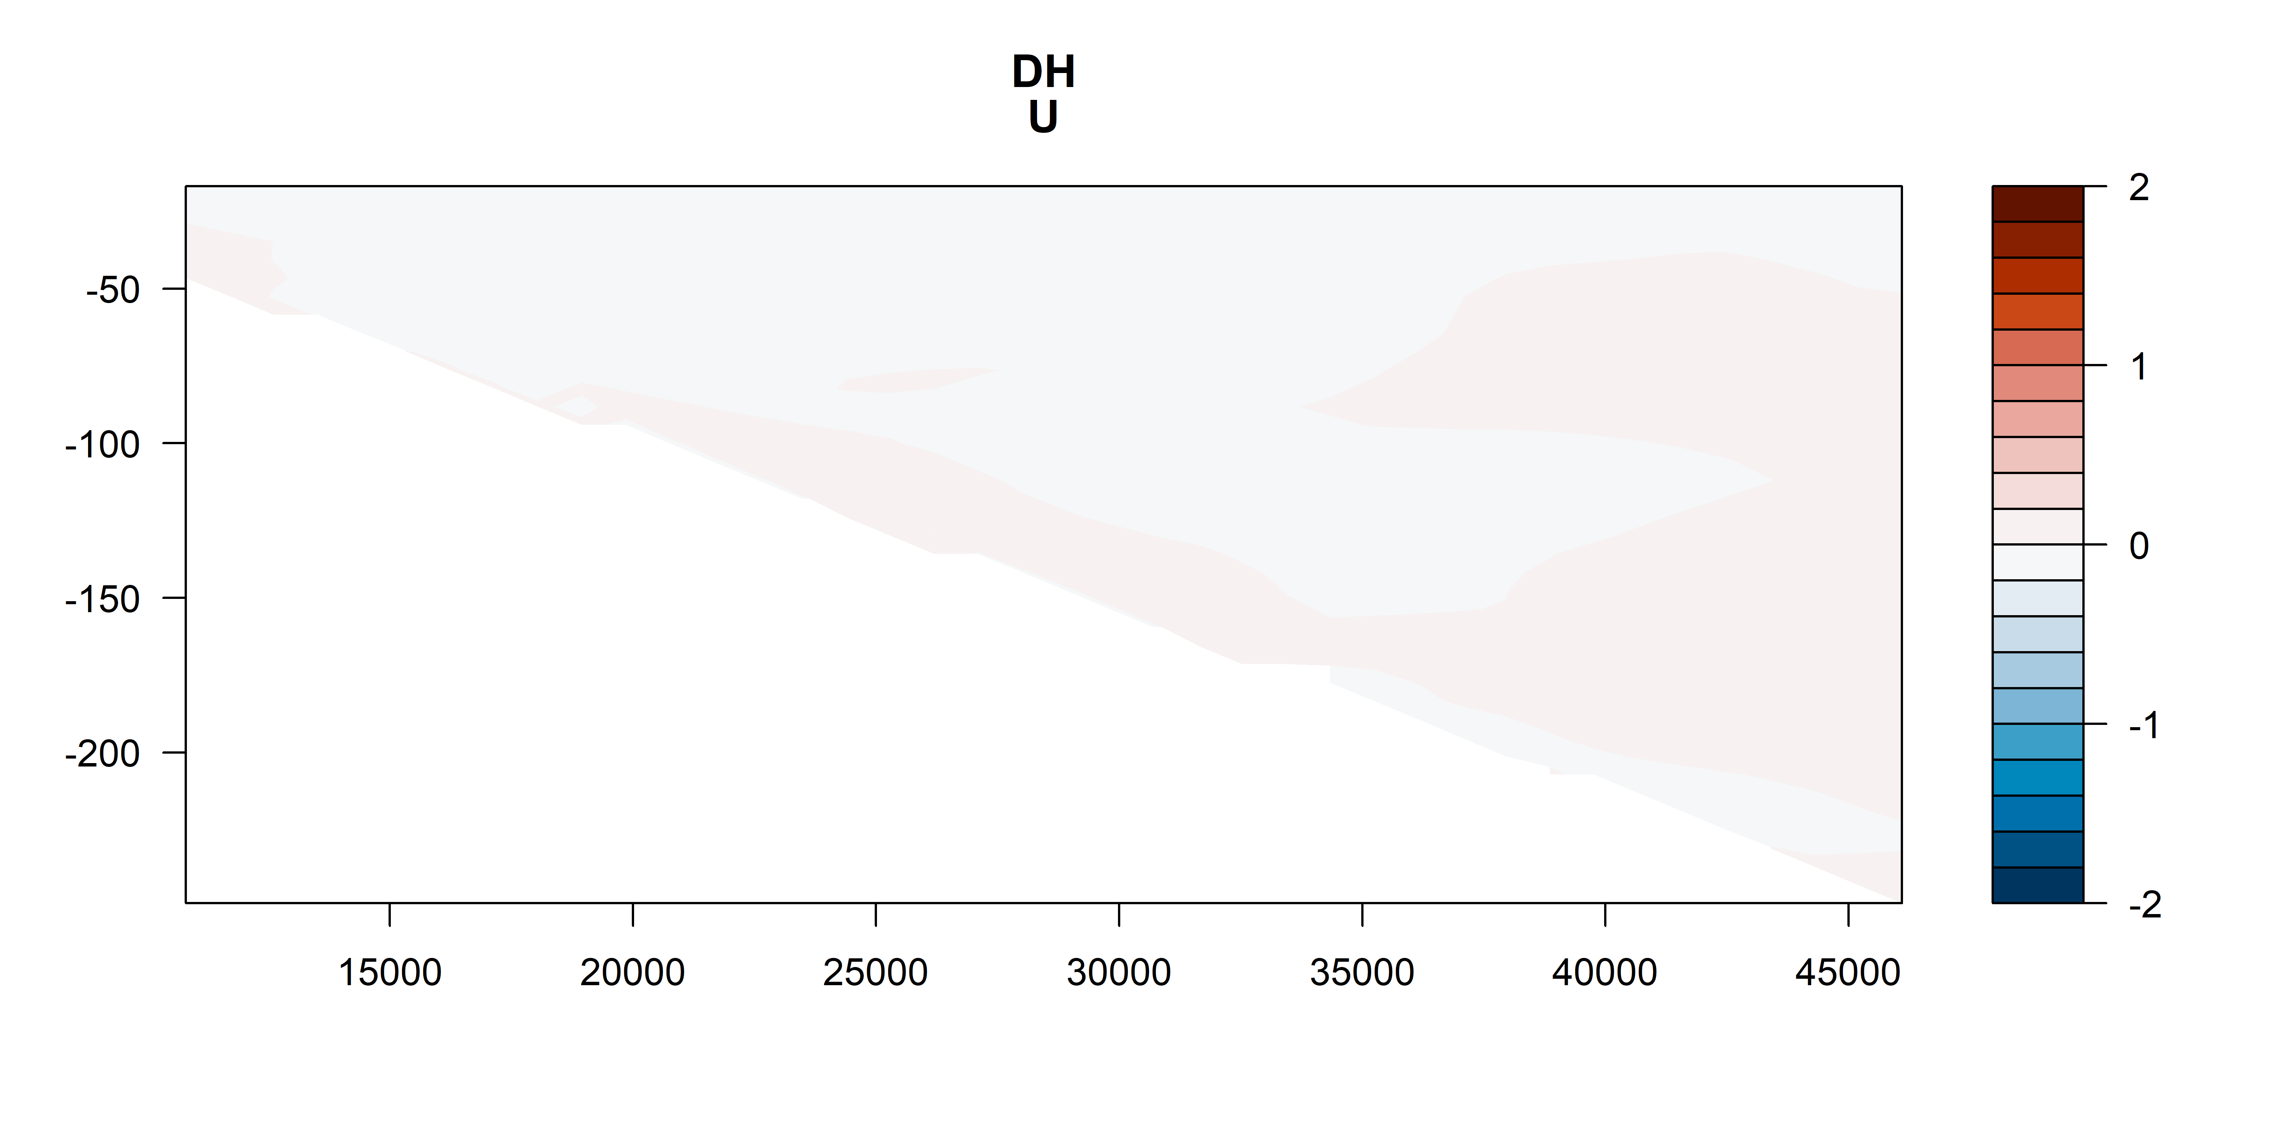
U vectors
m s⁻¹
m s⁻¹
m s⁻¹
m s⁻¹

Slide 35
U vectors – shoreline rotated (m s⁻¹)

Slide 36
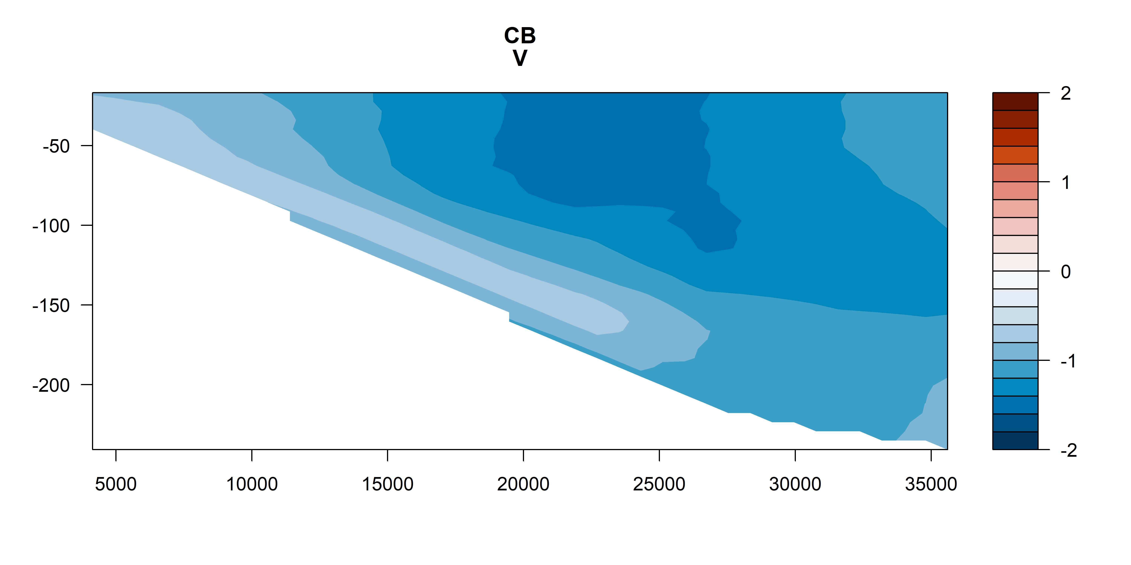
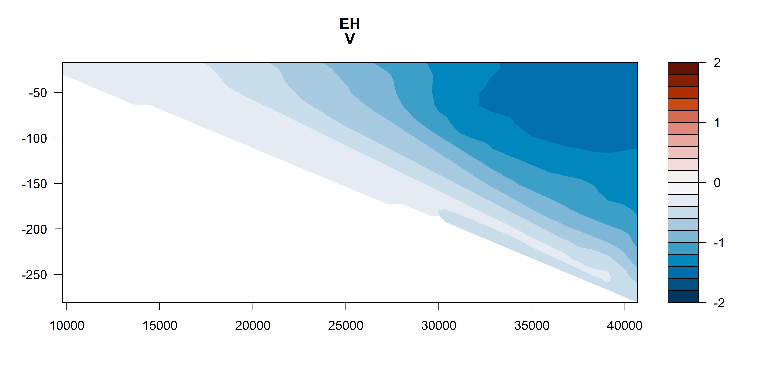
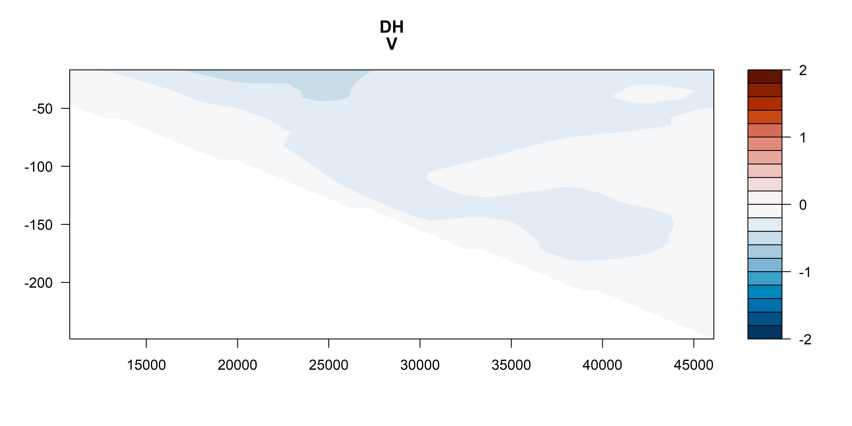
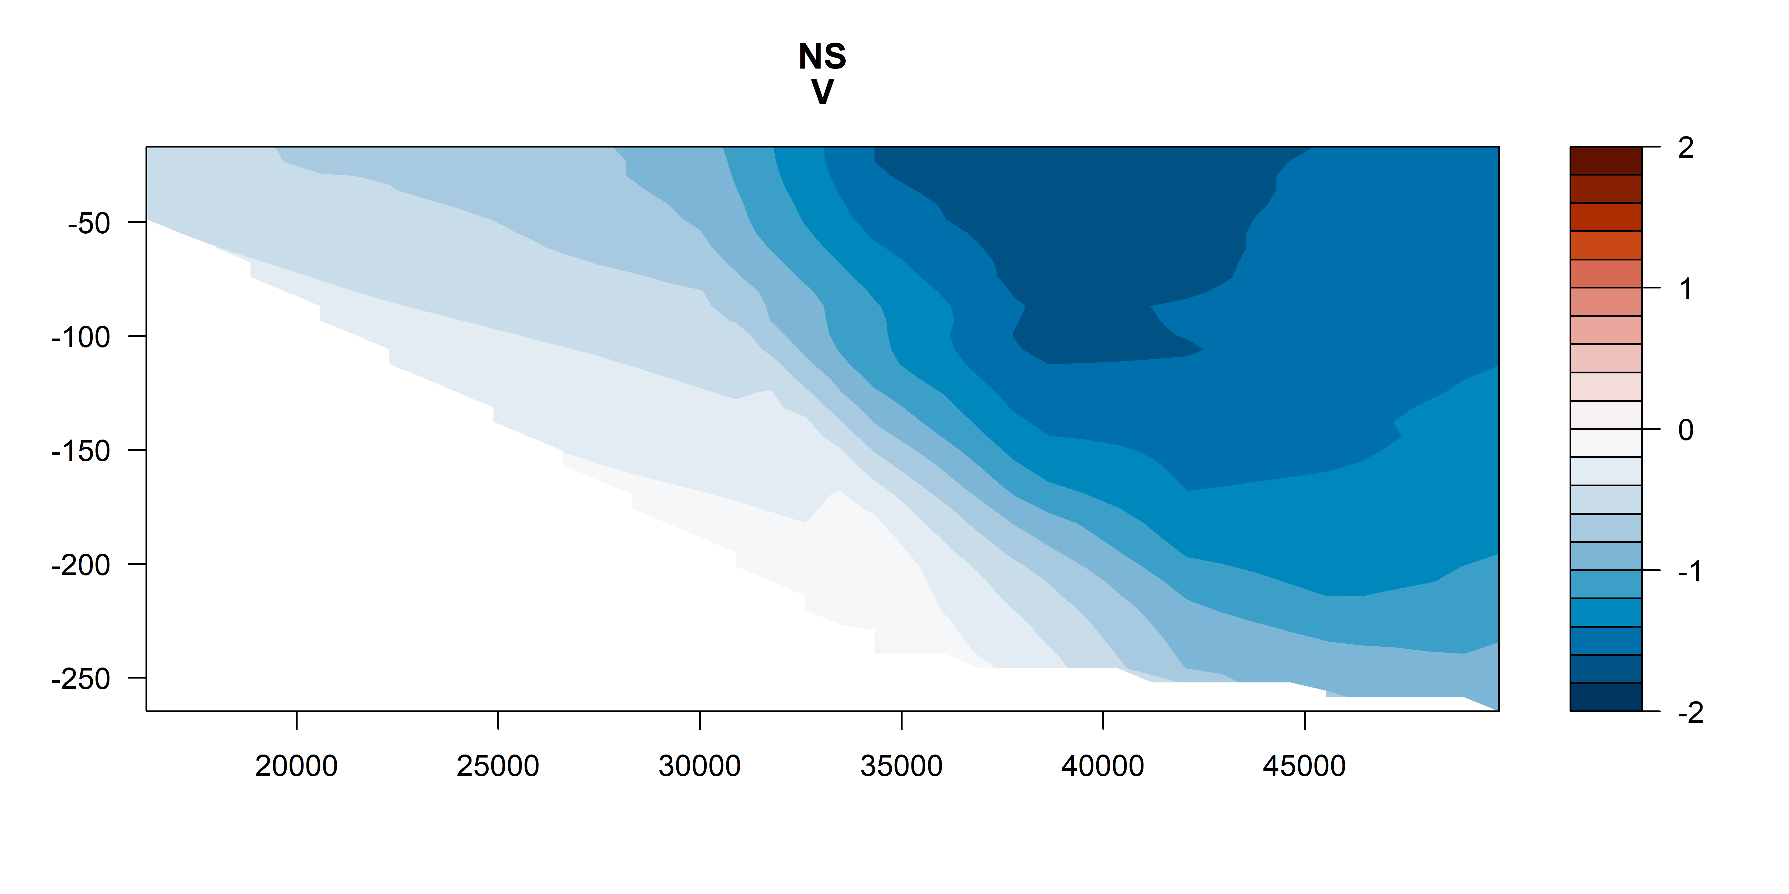
V vectors
m s⁻¹
m s⁻¹
m s⁻¹
m s⁻¹

Slide 37
V vectors – shoreline rotated (m s⁻¹)

Slide 38
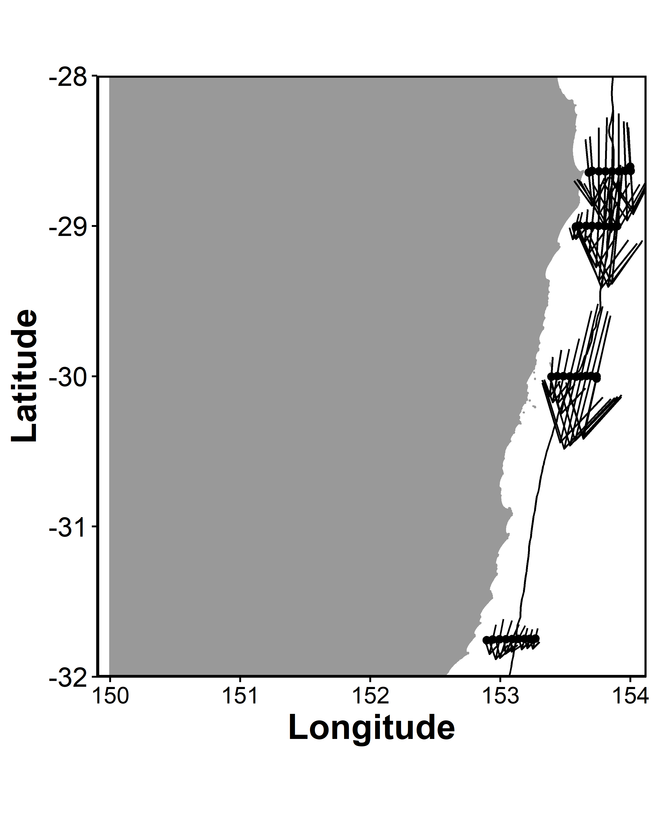
ADCP Velocity on a map

Slide 39



Nitrate

Slide 40



Silicate

Slide 41



Oxygen

Slide 42



Oxygen utilisation (expected – observed)
um/kg
Positive = respiration (lower O₂ than expected)
Negative = photosynthesis / production
um/kg
um/kg

Slide 43



Salinity

Slide 44



Temperature
Deg C
Deg C
Deg C

Slide 45



Chl_a

Slide 46



Chl_a top 200m

Slide 47



Nitrate

Slide 48



Silicate

Slide 49



Oxygen

Slide 50



Oxygen utilisation (top 200m)
um/kg
Positive = respiration (lower O₂)
Negative = photosynthesis / production
um/kg
um/kg

Slide 51



Salinity

Slide 52



Temperature

Slide 53

Zooplankton Biomass temperature contours

Slide 54
Zooplankton Biomass

Slide 55




NBSS Slope

Slide 56
Pareto Slope

Slide 57

Abundance

Slide 58




Abundance

Slide 59
Geometric Mean Size

Slide 60
Wind Stress
DH
EH
CB

Slide 61

Modelling Zooplankton Biomass
Call: lm(formula = Biomass ~ Temp + Salt + Depth + site + Distance_Coast, data = mydata)
All variables significant except Salinity (P = 0.25)
Adj R² = 0.58
No autocorrelation taken in account ☹

Slide 62

Modelling Pareto Slope
Call: lm(formula = ParetoSlope ~ Temp + Salt + Depth + site + Distance_Coast, data = mydata)
All variables significant except Depth (P = 0.25)
Adj R² = 0.33
No autocorrelation taken in account ☹

Slide 63
Expectations
Areas of upwelling should have higher nutrients and plankton abundance
Areas offshore (open ocean water) should have slopes closer to -1
Southern sites should have higher biomass (colder water influence)

Slide 64
Patterns
Inshore North Solitary shows some upwelling + higher nutrients + biomass
North Solitary, Evans Head and Cape Byron have high surface biomass offshore (but not abundance?) – this is weird Data error
Abundance (and biomass) increases towards the shelf (I think this is common but relatively unpublished?)

